Slide 1
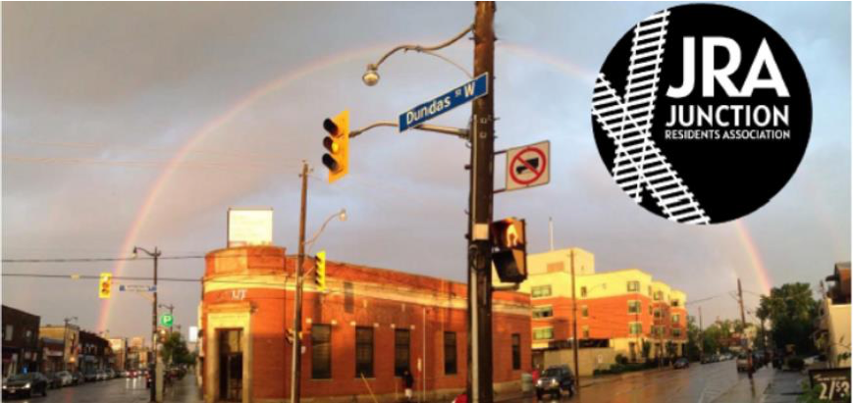
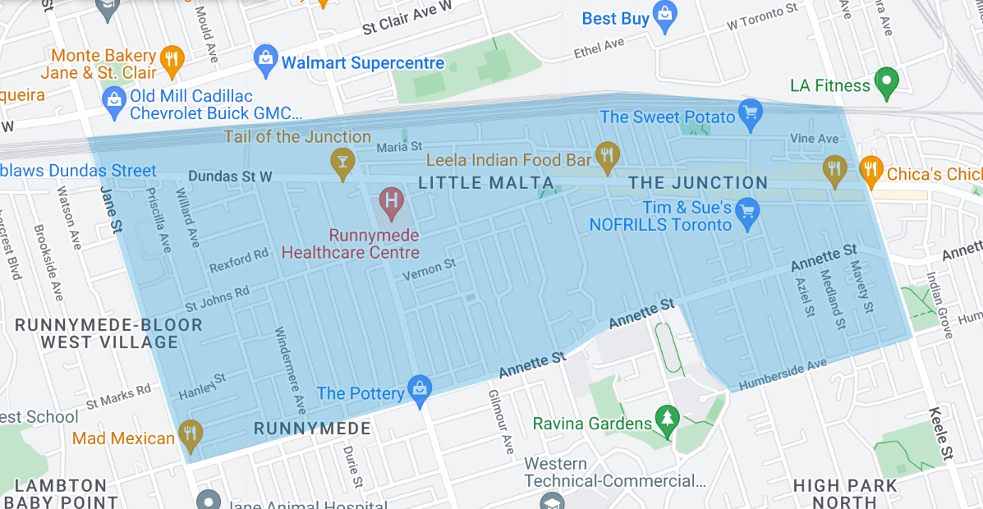
Design Your Main Street Study (DYMS)
Summary Presentation
By Researchers Alana Scauzillo and Lucinda Nonva, for the JRA

Slide 2
Acknowledgements & Sponsors
This project was made possible with funding provided by the Canada Summer Jobs Program, donations from the community, and sponsorship from our Community Partners, listed below:
Stu Sells Realty Team
Tuli Toronto Mortgage Expert
Gillian Ritchie, Broker & Alex Porritt, Sales Rep: Red Square Team, Royal LePage Real Estate Services
DYMS
We would like to take a moment to thank the community members who participated in the survey, the volunteers who spent countless hours supporting this effort, and Alana Scauzillo and Lucinda Nonva (researchers who were invaluable to the success of this project).

Slide 3
Introduction: Purpose and Aims
Purpose…
…an exploratory study, to collect and analyze neighbourhood and individual’s perspectives, lived experiences, and concerns about various features of the main street (Dundas Street West) and in relation to the overall neighbourhood, with reference to municipal public policy objectives (e.g., the Official Plan) within the City of Toronto.
Why? Lack of City of Toronto budget to conduct formal main street/avenue study, and in response to concerns regarding the effects of recent city-wide policy¹ and local infrastructural developments²
Aims…
… to elicit community and business perspectives, engage local residents and business owners, engage community members and leaders, create a local study with social sciences research principles in mind, to provide a platform through which local perspectives and concerns are forefront, and to ultimately create a final report that can function as a point-of-reference and community tool in capturing community aspirations for neighbourhood change and development(s).
Notes:
¹ https://www.toronto.ca/city-government/planning-development/official-plan-guidelines/official-plan/
² https://craftresidences.ca/neighbourhood/

Slide 4
Introduction: Research Questions and Timeline
Research Questions…
What are the perspectives and concerns of The Junction area residents and business owners regarding the development, qualities and characteristics of the main street (Dundas Street West)?
How can these perspectives and concerns effectively inform the evolution and development of the main street and the neighbourhood?
Timeline…
June 5th and ran until July 28th, with some preliminary online research being conducted in the two weeks prior to June 5th.
Week of the June 5th, the researchers created, edited and finalized the survey to be launched the following week.
Week of June 12th, researchers planned observation and sampling, created and published social media posts, and conducted background research.
Observation began on June 15th until June 22nd
Week of June 19th the researchers put up posters to advertise the study and began business canvassing through which some information cards were dropped off.
Week of June 26th to mid-July: residential canvassing
The researchers also set up tents at three community events for recruitment: the Junction Community Fun Day (June 25th), the Annette Village Farmers’ Market (July 12), and the Junction Farmers’ Market (July 22).
Survey closed July 24th at 11:55pm, report creation thereafter
Inclusion Criteria: 18+ years of age, business owner and/or resident in or bordering onto the JRA catchment area

Slide 5
Sources: Literature and Methodologies
Literature Review for information:
JRA and BIA Work
City of Toronto documents
Main Street Studies
Scholarly Studies and Measures
Main Methods:
Survey
Participant Observation
Canvassing - Sampling
Online and in-person recruitment
Examples:
Junction Gardens BIA’s 2014 Streetscape Master Plan Vision³
Planning Studies, the Official Plan, Zoning differences in the Junction
Defining the main street, empirically comparing US cities and ‘vitality’, third place theory, localization and socialization functions & benefits, engagement & identity
Residential/neighbourhood satisfaction/contentment theories, assoc. Variables and measures for survey, streetscape design and transportation, defining variables (e.g, greenery, walkability), health-related and well-being measures, Toronto and Canadian well-being/community-building studies
Methods Details:
Google Forms, Google Sheets
Observation - Dundas intersections, with inspo drawn from Streetscape Master Plan (above)
Sampling - random sampling of streets based on JRA catchment area clusters; up to six streets per cluster chosen, each house visited; each business on Dundas visited, some info cards left
Events (see previous slide); posters on community boards
Notes:
³ https://torontojunction.ca/2014-streetscape-master-plan

Slide 6
Overview & Thematic Breakdown - Observations and Survey
Observations
Locations, comparative analyses:
Major Intersections
Keele and Dundas
Runnymede and Dundas
Jane and Dundas
Smaller/Intermediate Intersections
Medland and Dundas
Pacific and Dundas
High Park and Dundas
McMurray and Dundas
Quebec and Dundas
Clendenan and Dundas
St. John’s Road and Dundas
St. John’s Place and Dundas
Gilmour and Dundas
Themes:
Infrastructure, transportation, environment, activity, and relatively unique area qualities.
Survey
Participants: 315 total
Themes:
Infrastructure–including accessibility and housing, Community–including heritage and greenery, Economy, Socialization, Demographic questions concluding the survey.

Slide 7
Observations - Overview of Findings
Major Intersections - Keele, Runnymede and Jane
Infrastructure, transportation, environment, activity, and relatively unique area qualities
Beautiful historic-looking buildings, including a plaque in front of BMO (Keele); minimal to no benches, including planters & trees
Traffic, hectic, throughway oriented, less leisure focus, less pedestrian and cyclist focus, except Runnymede somewhat (has bike lanes), and Jane is more transit oriented
Keele and Jane relatively more clean than Runnymede, though all tend to have a strong vehicle fume smell & engine noise
Keele as connecting to Stockyards, Runnymede to Jane - employment/industrial zoning, Jane as transit corridor & heavy road construction

Slide 8
Observations - Overview of Findings
Smaller/Intermediate Intersections
Infrastructure, transportation, environment, activity, and relatively unique area qualities
Pedestrian & cyclist supports - e.g., bike parking (latter is not as adequate), ambiance and types of businesses - local orientation & leisure, road structures - more movement of people
Pedestrian and cyclist movements & behaviours - jaywalking prominent & many families or couples, vehicle flow and traffic - consistent flow & greater vehicle orientation
More small-town feel, trees and planters looked cleaner and more plentiful, streets are relatively clean, sounds of birds can be heard, better access to parkette and Malta Park & seating
Local businesses plentiful, fewer pedestrians and conversations to be heard, awkward juxtaposition of vehicle traffic/throughway function of Dundas and intersections & neighbourhood main street function
Eclectic and historic; where are the speed limit signage?; a lot of potential to improve walkability/cycling, green space maintenance, and community activity - e.g., adding benches west of Clendenan, adding bike parking, pedestrian crosswalks & artwork, removing litter from parks and introducing native plant species, etc.

Slide 9
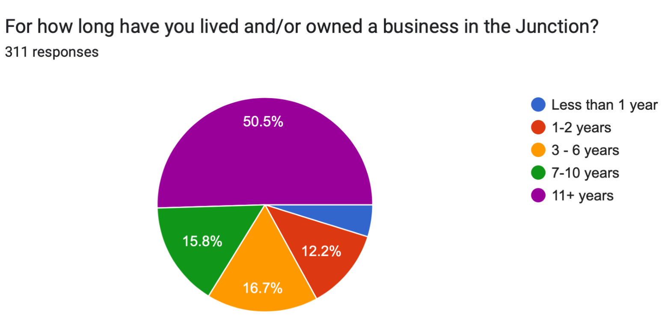
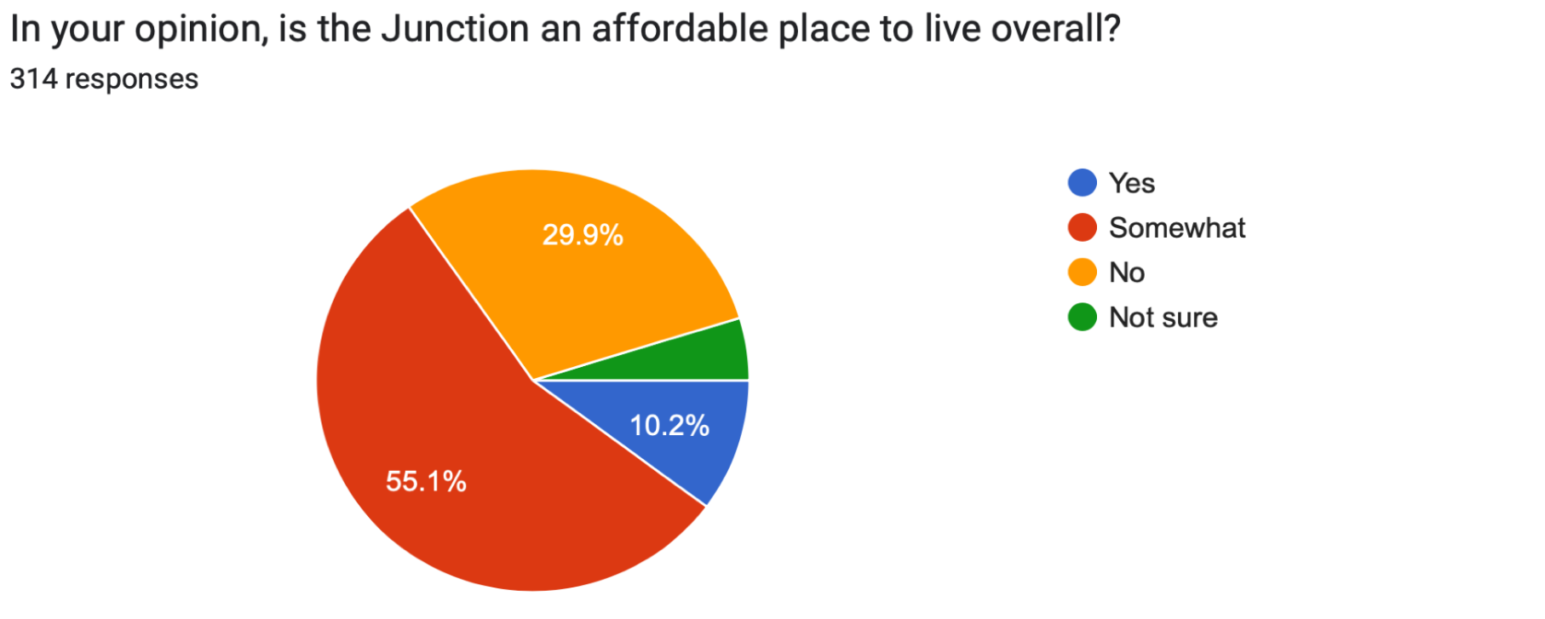
Results Summary - Answering Research Q #1
What are the perspectives and concerns of The Junction area residents and business owners regarding the development, qualities and characteristics of the main street (Dundas Street West)?
Survey Overall Findings –
Infrastructure–including accessibility and housing
Community–including heritage and greenery
Economy
Socialization
Demographic questions concluding the survey.
Distance to the main street: Almost 72% of participants live within a 0-5 minute walk from Dundas St. W.
Combined, around 57% of our sample recorded spending everyday or almost everyday on the main street.

Slide 10
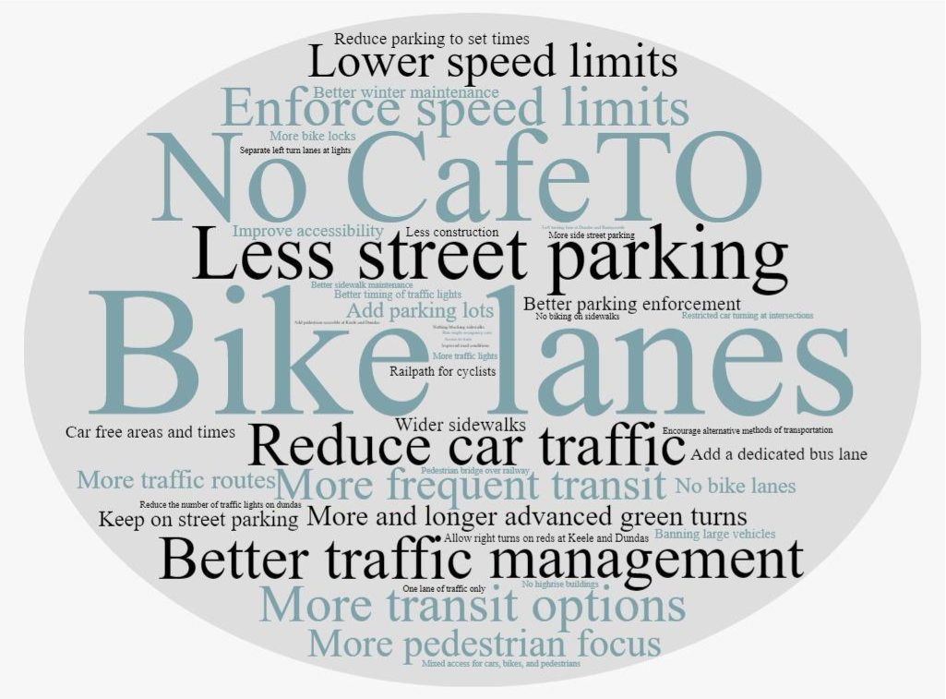
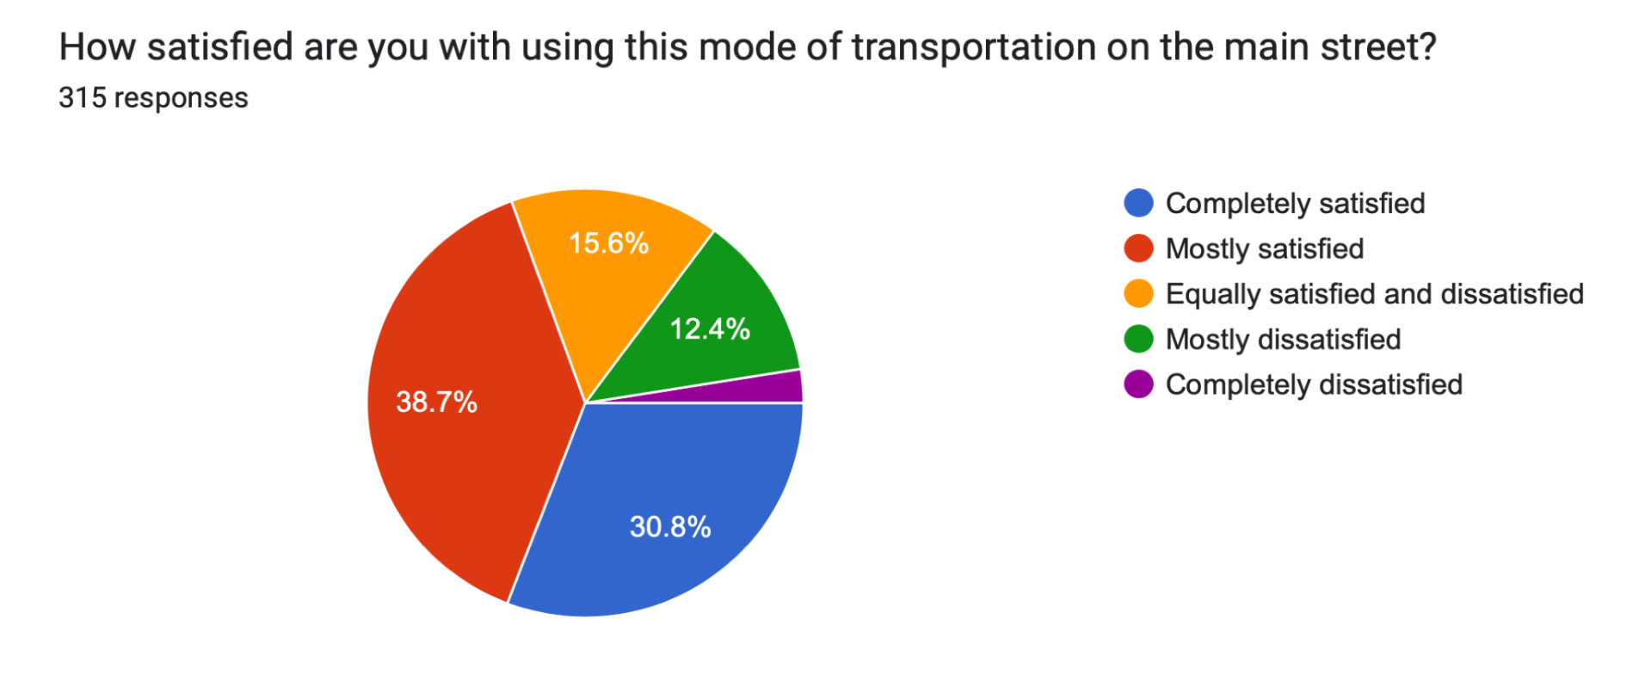
Results Summary - Answering Research Q #1
Mode of Transportation on the Main Street, on a weekly basis:
Around 67% walk on the main street
Almost 17% use a personal vehicle
Around 8% use a bicycle
Around 4% stated public transit
What would improve the ease of transportation on the main street? (right)
● Overall Quality of Housing:
○ Around 47% are ‘mostly satisfied’
Top Two Housing Preferences:
Fully detached homes
Semi-detached homes
Adequate access to basic services on the main street?
● Almost 44% stated to ‘a large extent’
● Around 31% stated to ‘a moderate extent’
Main Street Accessible for Cyclists?
Around 40% stated to ‘a small extent’
27% stated ‘not at all’
Encourage Cycling on the Main Street?
Yes at almost 70%
No at around 23%

Slide 11
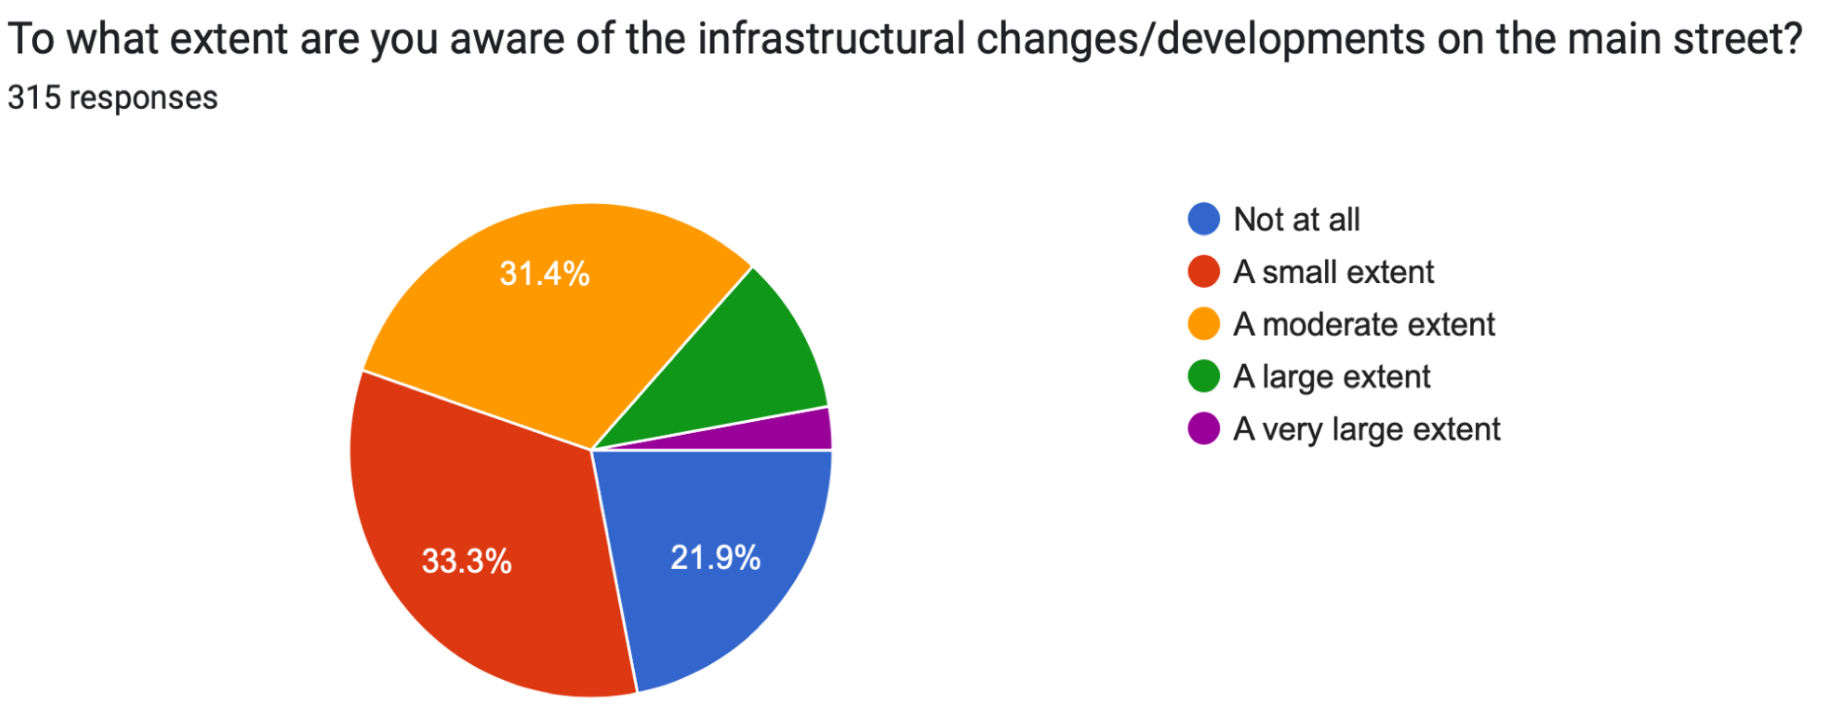
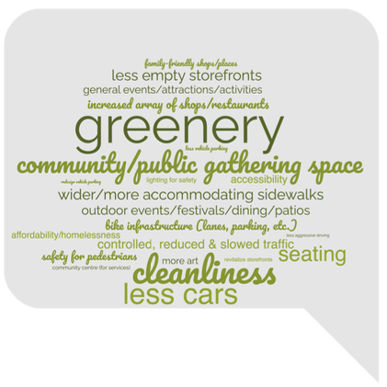
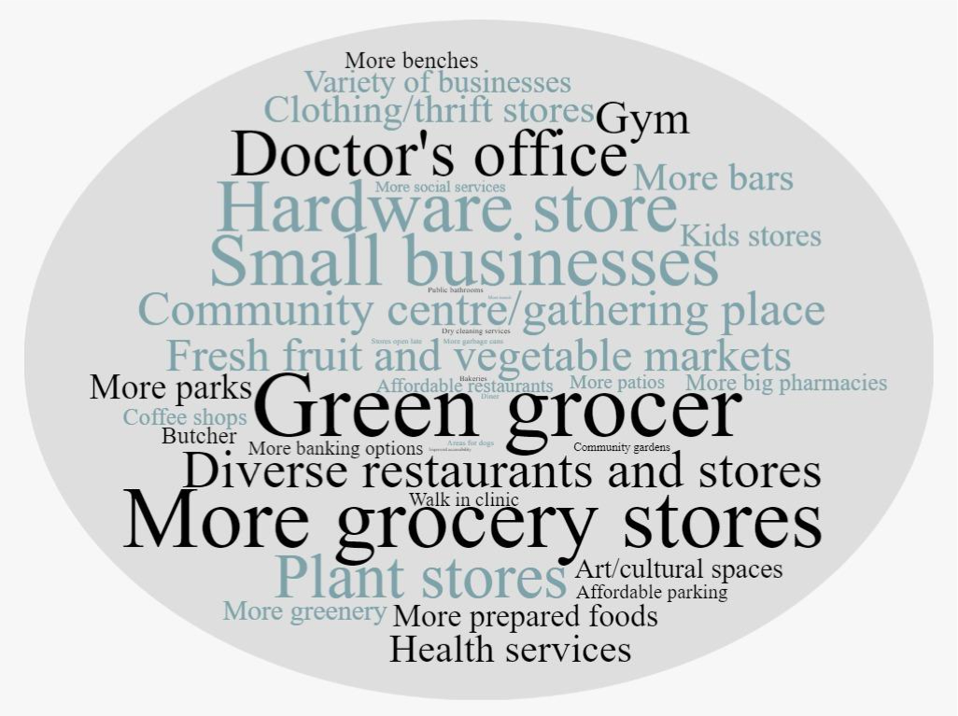
Results Summary - Answering Research Q #1
What would make the main street a more welcoming environment? (left)
What types of amenities/services would you like to see more of on the main street? (right)

Slide 12
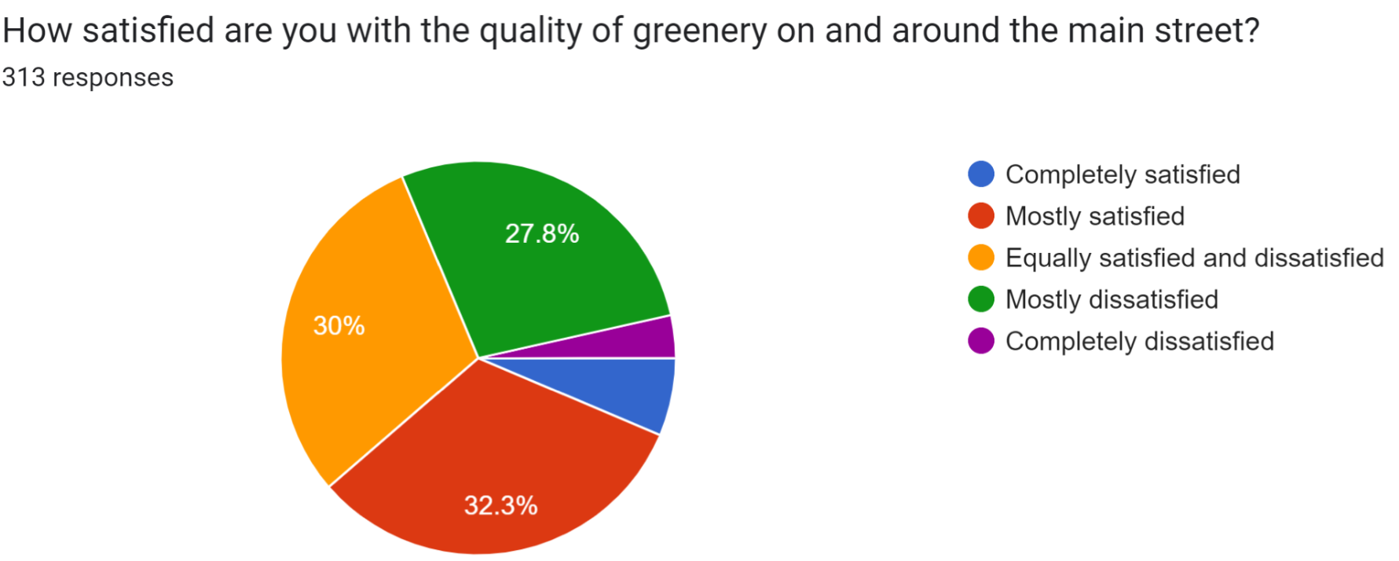
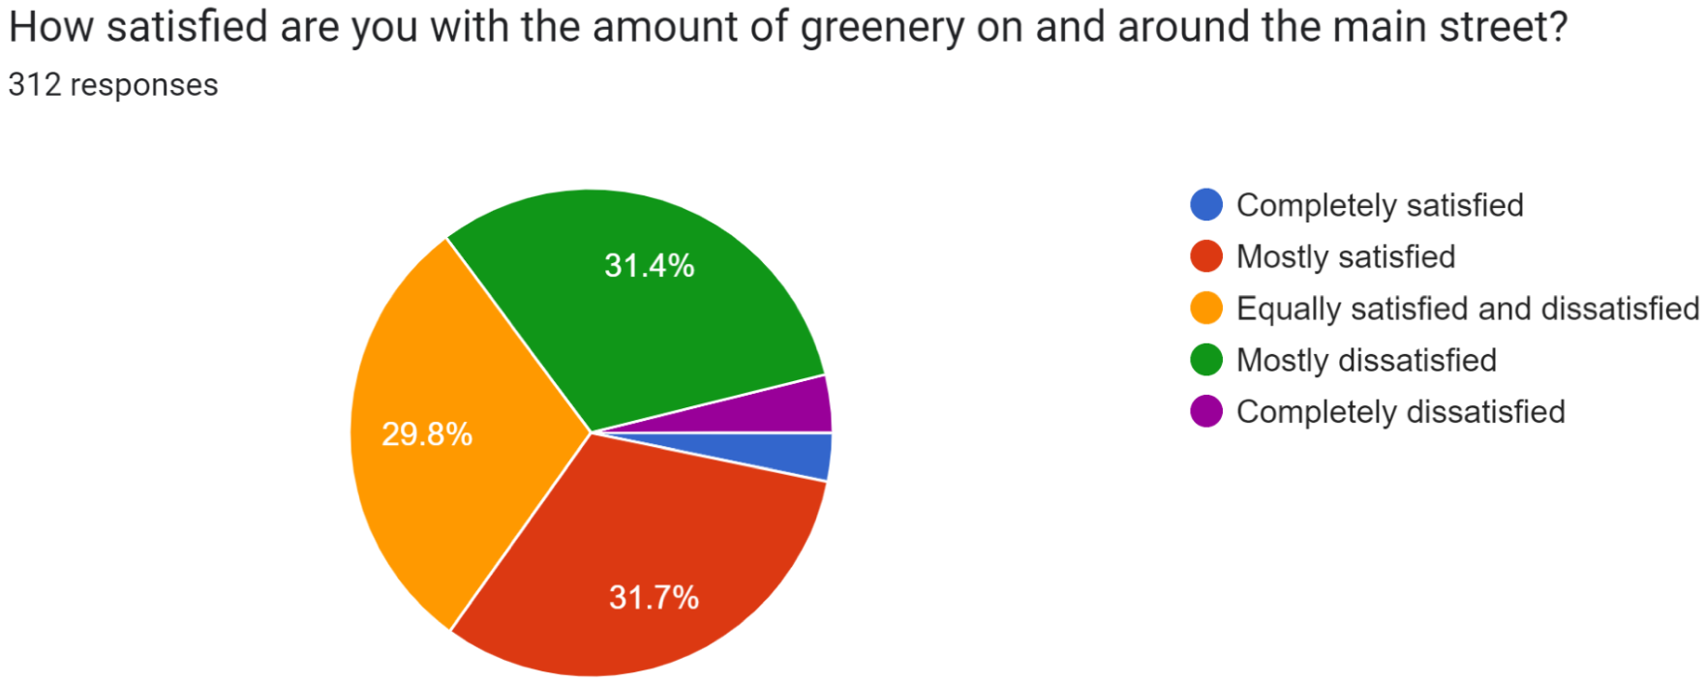
Results Summary - Answering Research Q #1
Almost 84% have participated or do participate in community activities and events in the Junction
Do you feel welcome on the Junction main street? ● Around 84% stated Yes
Is the Junction family-friendly? ● Around 82% stated Yes
Sense of Safety: ● Around 62% stated ‘I feel safe most of the time’
Around 79% stated that they would like to see more public artwork on the main street

Slide 13
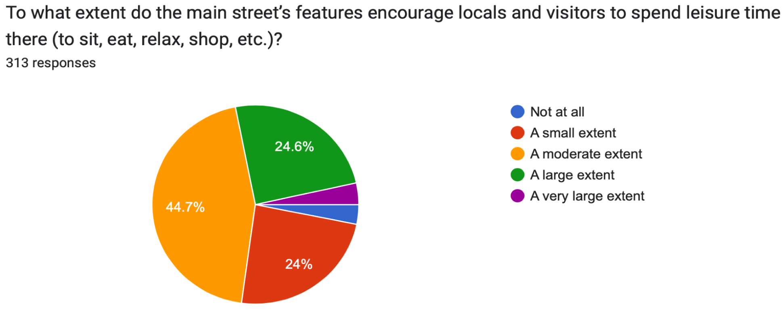
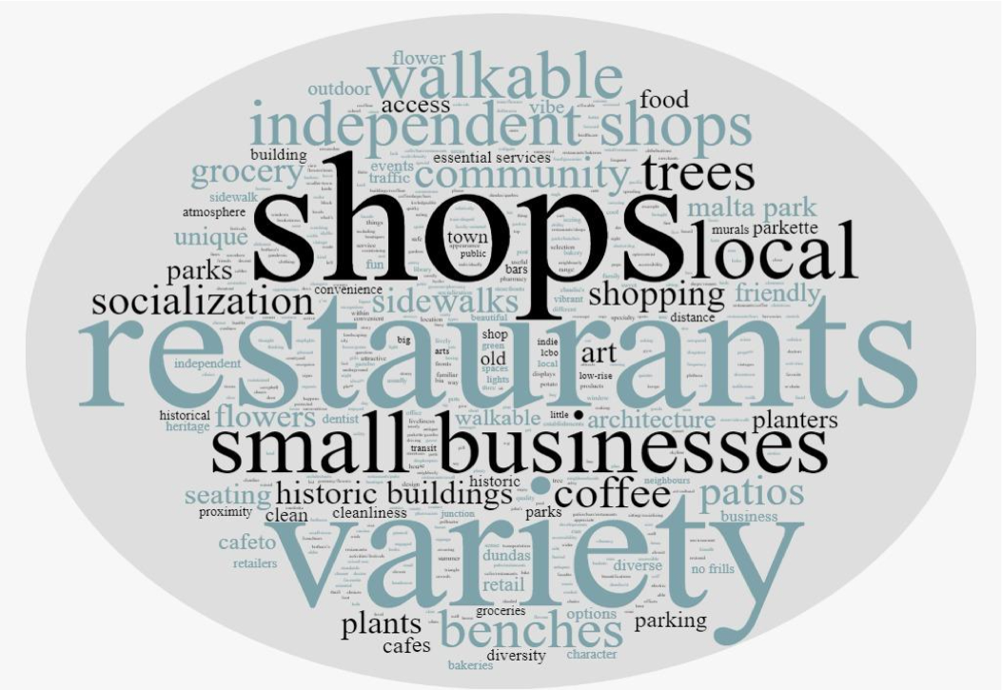
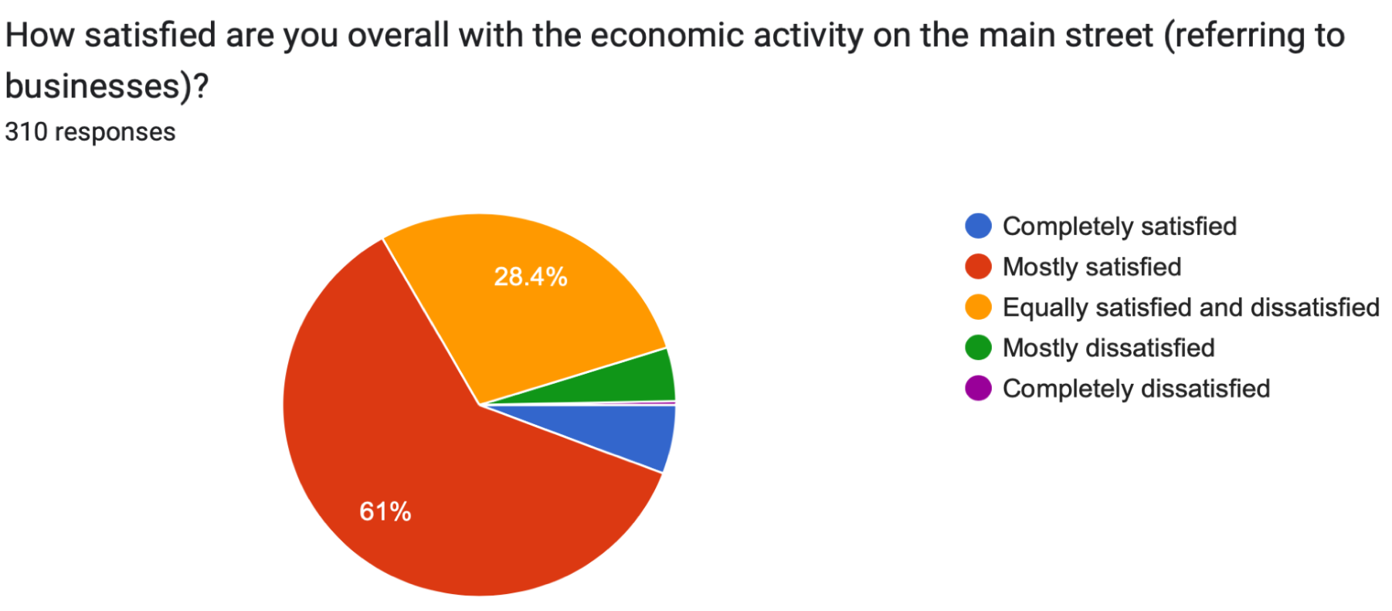
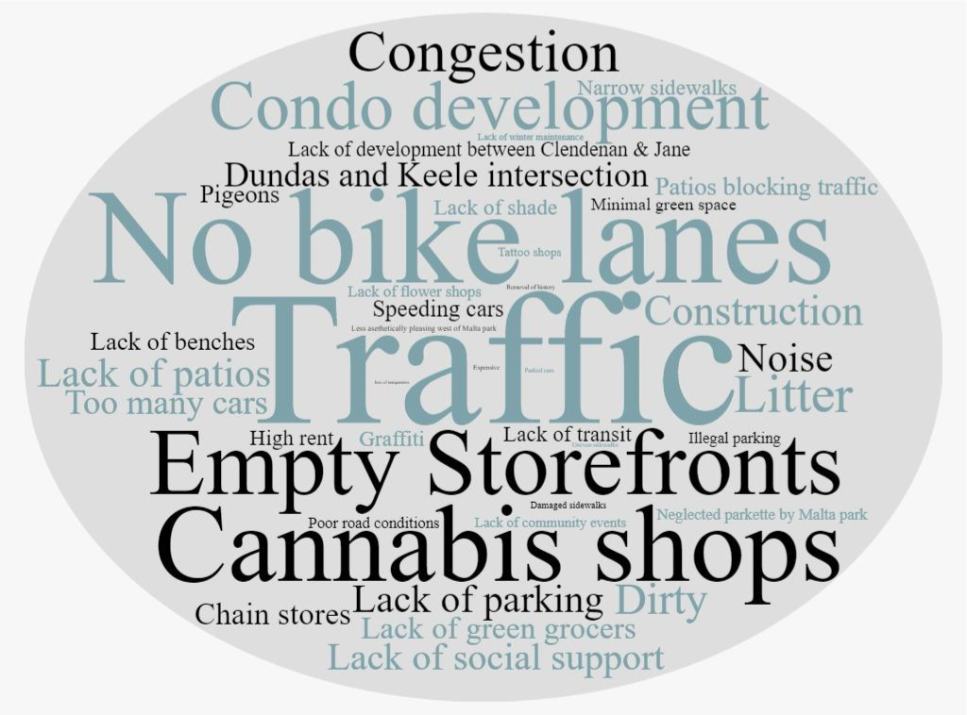
Results Summary - Answering Research Q #1
Most (above)
Least (left) favourite features of Main Street

Slide 14
Answering Research Q #2
How can these perspectives and concerns effectively inform the evolution and development of the main street and the neighbourhood?
Findings can be thought of thematically, categorically, and comparatively to put responses into conversation and help achieve a bigger picture vision of the community.
Residents, business owners, and other stakeholders can consult this information to better understand how perspectives on accessibility, for example, can help inform improvements to socialization
Kick-start a community strategy that creates a more suitable, agreeable and enjoyable neighbourhood.
Assessing and understanding the evolution and development of main streets requires consideration of the perspectives and concerns of residents and stakeholders themselves, as also related to levels of satisfaction, experiences, and functionality.
This report, among other informational materials, is just one way to illustrate how the perspectives of some participants from the same community may vary from or align with others’ perspectives.
Knowledge sharing & building
The observational work is just one way of illustrating how those outside the community may see it, especially as the Junction is just one neighbourhood within a big city. This may function as a launching off point for greater community engagement and flow of discussion.

Slide 15
Strengths, Limitations and Suggestions
Strengths
First of its kind in the neighbourhood, given its social sciences methods focus, survey layout, and various research components for data collection
Canvassed at many streets (six per cluster), and considering limited number of months, we are pleased with our sample size
Consistent survey measure format (Likert scale); no loaded or leading questions; open-ended to encourage feedback; logical flow of questions
Literature-informed measures and concepts included
Participant biases were limited to the best of abilities of researchers (avoiding pressuring participants to give certain types of answers)
Limitations
No advanced statistical analyses (e.g., regressions)
Representativeness not guaranteed, though random sample was achieved
Accessible formats limited (some paper copies and larger survey font online); recruitment cards brought to Four Villages centre
Limited access to recruitment in apartments
At this stage, only cross-sectional (a one-time) study
Suggestions
Repeat this sort of study
Outreach to youth, elderly and marginalized groups

Slide 16
Ways Forward
Current Heritage Conservation District phase one development in the Junction being conducted, some exciting opportunities to merge ideas⁴
Inclusion of: developers, planners, political representatives, and policy makers in other studies/work to build off of
Knowledge mobilization/translation
Developing more accessible formats of reports, and tools for community outreach, engagement and education
Conveying important city-wide information that is impactful on community in ways that openly and effectively inform
Community organizations should build/work on resource sharing strategies to reach wider audience in community
Notes:
⁴ https://www.toronto.ca/city-government/planning-development/heritage-preservation/heritage-conservation-districts-planning-studies/

Slide 17
References
Abass, Z. I., & Tucker, R. (2018). Residential satisfaction in low-density Australian suburbs: The impact of social and physical context on neighbourhood contentment. Journal of Environmental Psychology, 56, 36–45.
https://doi-org.proxy1.lib.uwo.ca/10.1016/j.jenvp.2018.02.005
Abidin, N. Z., Abdullah, M. I., Basrah, N., & Alias, M. N. (2019). Residential satisfaction: Literature review and aconceptual framework. IOP Conference Series. Earth and Environmental Science, 385(1), 1-9. DOI10.1088/1755-1315/385/1/012040.
ACTO. (2018). Where Will We Live? Ontario’s Affordable Rental Housing Crisis. In Advocacy Centre for TenantsOntario.
Angus Reid Institute. (2022). Reshaping communities: Discontent with community design drives a push formore inclusive architecture.
https://angusreid.org/reshaping-communities-rise-for-architecture/.
Brown, M., Fonberg, J., Schellenberg, G., & Yang, R. (2021). Neighbourhood characteristics and life satisfaction of individuals in lower-,middle-, and higher-income families in Canadian metropolitan areas. Statistics Canada.
Canadian Index of Wellbeing. (n.d.). Domains and Indicators. https://uwaterloo.ca/canadian-index-wellbeing/what-we-do/domains-and-indicators
Carr, D., Heger Boyle, E., Cornwell, B., Correll, S., Crosnoe, R., Fresse, J., Waters, M. C. (2021). S. Levitt & E.Nakagawa (Eds.), The Art and Science of Social Research. (2nd ed.). W. W. Norton & Company.
Chum, A., Atkinson, P., & O’Campo, P. (2019). Does time spent in the residential neighbourhood moderate the relationship between neighbourhood walkability and transport-related walking? A cross-sectional study from Toronto, Canada. BMJ Open, 9(4), 1-7.
https://doi-org.proxy1.lib.uwo.ca/10.1136/bmjopen-2018-023598.
City of Toronto. (2020). City planning neighbourhood survey.
https://www.toronto.ca/legdocs/mmis/2020/ph/bgrd/backgroundfile-148584.pdf
City of Toronto. (2020).The current state and future of Toronto’s retail main streets.
https://www.toronto.ca/wp-content/uploads/2020/11/9826-Current-State-and-Future-of-To rontos-Retail-Main-Streets-Full-Report-Final-Jan-2020-compressed.pdf
City of Toronto. (n.d.). Toronto main street recovery and rebuild initiative. https://www.toronto.ca/business-economy/business-operation-growth/business-incentive s/toronto-main-street-recovery-and-rebuild-initiative/
Claveau, J. (2019). Satisfaction of Canadian households with their neighbourhood: Highlights from the 2018 Canadian Housing Survey. Statistics Canada.https://www150.statcan.gc.ca/n1/pub/75f0002m/75f0002m2019012-eng.htm

Slide 18
References
den Braver, N. R., Lakerveld, J., Gozdyra, P., van de Brug, T., Moin, J. S., Fazli, G. S., Rutters, F., Brug, J., Moineddin, R., Beulens, J. W. J., & Booth, G. L. (2022). Development of a neighborhood drivability index and itsassociation with transportation behavior in Toronto. Environment International, 163, 1-12.https://doi.org/10.1016/j.envint.2022.107182.
Emami, A., & Sadeghlou, S. (2021). Residential satisfaction: A narrative literature review towards identification of coredeterminants and indicators. Housing, Theory and Society, 38(4), 512–540. https://doi-org.proxy1.lib.uwo.ca/10.1080/14036096.2020.1844795.
Gianfredi, V., Buffoli, M., Rebecchi, A., Croci, R., Oradini-Alacreu, A., Stirparo, G., Marino, A., Odone, A., Capolongo, S., & Signorelli, C. (2021). Association between urban greenspace and health: A systematic review of literature. International Journal of Environmental Research and Public Health, 18(10), 1-23.
https://doi-org.proxy1.lib.uwo.ca/10.3390/ijerph18105137
Gosse, M., Ramos, H., Radice, M., Grant, J. L., & Pritchard, P. (2016). What affects perceptions of neighbourhoodchange? The Canadian Geographer, 60(4), 530–540.
https://doi-org.proxy1.lib.uwo.ca/10.1111/cag.12324
Helliwell, J. F., Shiplett, H., & Barrington-Leigh, C. P. (2019). How happy are your neighbours? Variation in life satisfaction among 1200 Canadian neighbourhoods and communities. PloS One, 14(1), 1-24.http://dx.doi.org.proxy1.lib.uwo.ca/10.1371/journal.pone.0210091
Hillier, A., Cannuscio, C. C., Griffin, L., Thomas, N., & Glanz, K. (2014). The value of conducting door-to-door surveys. International Journal of Social Research Methodology, 17(3), 285–302. https://doi-org.proxy1.lib.uwo.ca/10.1080/13645579.2012.733173
Kite, M. E., & Whitley, B. E. (2018). Survey research. In M. E. Kite and B. E. Whitley (Eds.), Principles of research in behavioral science (4th ed., pp. 567–617). Routledge.https://doi.org/10.4324/9781315450087-15.
Krosnick, J., Lavrakas, P., & Kim, N. (2014). Survey Research. In H. Reis & C. Judd (Eds.), Handbook of ResearchMethods in Social and Personality Psychology (pp. 404-442). Cambridge: Cambridge University Press.doi:10.1017/CBO9780511996481.020
Lee, S. M., Conway, T. L., Frank, L. D., Saelens, B. E., Cain, K. L., & Sallis, J. F. (2017). The relation of perceived andobjective environment attributes to neighborhood satisfaction. Environment and Behavior, 49(2), 136–160.
https://doi-org.proxy1.lib.uwo.ca/10.1177/0013916515623823.

Slide 19
References
McGirr, E., Skaburskis, A., & Donegani, T. S. (2015). Expectations, preferences and satisfaction levels among new andlong-term residents in a gentrifying Toronto neighbourhood.
Urban Studies, 52(1), 3–19.
https://doi-org.proxy1.lib.uwo.ca/10.1177/0042098014522721.
Mehta, V., & Bosson, J. K. (2009). Third places and the social life of streets. Environment and Behavior, 42(6), 779–805.https://doi.org/10.1177/0013916509344677
Mehta, V. (2011). Small Businesses and the Vitality of Main Streets. Journal of Architectural and Planning Research,28(4). http://www.jstor.org/stable/43030948
Mouratidis, K., & Yiannakou, A. (2022). What makes cities livable? Determinants of neighbourhood satisfaction andneighbourhood happiness in different contexts. Land Use Policy, 112, 1-13.https://doi.org/10.1016/j.landusepol.2021.105855.
OECD. (2013). OECD guidelines on measuring subjective well-being. OECD Publishing, Paris.https://doi.org/10.1787/9789264191655-en.
OECD. (n.d.). Measuring and managing business impacts on people’s well-being and sustainability.
https://www.oecd.org/wise/measuring-business-impacts-on-peoples-well-being.htm
OECD. (n.d.). MeasuringWell-being and Progress: Well-being Research.
https://www.oecd.org/wise/measuring-well-being-and-progress.htm
Okulicz-Kozaryn, A. (2013). City life: rankings (livability) versus perceptions (satisfaction). Social Indicators Research,110(2), 433–451. .
https://doi-org.proxy1.lib.uwo.ca/10.1007/s11205-011-9939-x
Pendola, R., & Gen, S. (2008). Does “main street” promote sense of community? A comparison of San Francisco neighborhoods. Environment and Behavior, 40(4), 545–574. https://doi.org/10.1177/0013916507301399
Permentier, M., Bolt, G., & van Ham, M. (2011). Determinants of neighbourhood satisfaction and perception of neighbourhood reputation. Urban Studies, 48(5), 977–996. https://doi.org/10.1177/0042098010367860

Slide 20
References
Smrke, U., Blenkuš, M., & Sočan, G. (2018). Residential satisfaction questionnaires: A systematic review. Urbani Izziv,29(2), 67–82. DOI:10.5379/urbani-izziv-en-2018-29-02-001
Statistics Canada. (2022). Canadian Housing Survey. https://www23.statcan.gc.ca/imdb/p3Instr.pl?Function=assembleInstr&lang=en&Item_Id= 1479765#qb1485848
Statistics Canada. (n.d.). Quality of Life hub.
https://www160.statcan.gc.ca/index-eng.htm#:~:text=The%20Quality%20of%20Life%20Framework%20for%20Canada%20brings%20together%20data,based%20decision%20making%20and%20budgeting.
Talen, E., & Jeong, H. (2019). What is the value of ‘main street’? Framing and testing the arguments. Cities, 92, 208-218. https://doi.org/10.1016/j.cities.2019.03.023.
Tracy, S. J. (2019). Qualitative research methods: Collecting evidence, crafting analysis, communicating impact (2nded.). Wiley-Blackwell.

