Slide 1
Community Building:
A look at the past year and what lies ahead for the JRA
Junction Residents Association
Annual General Meeting
November 2024

Slide 2
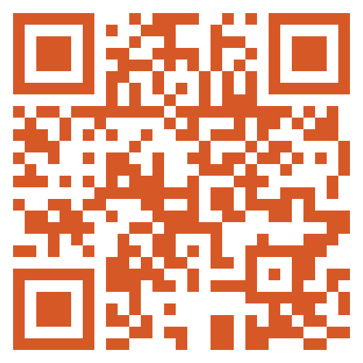
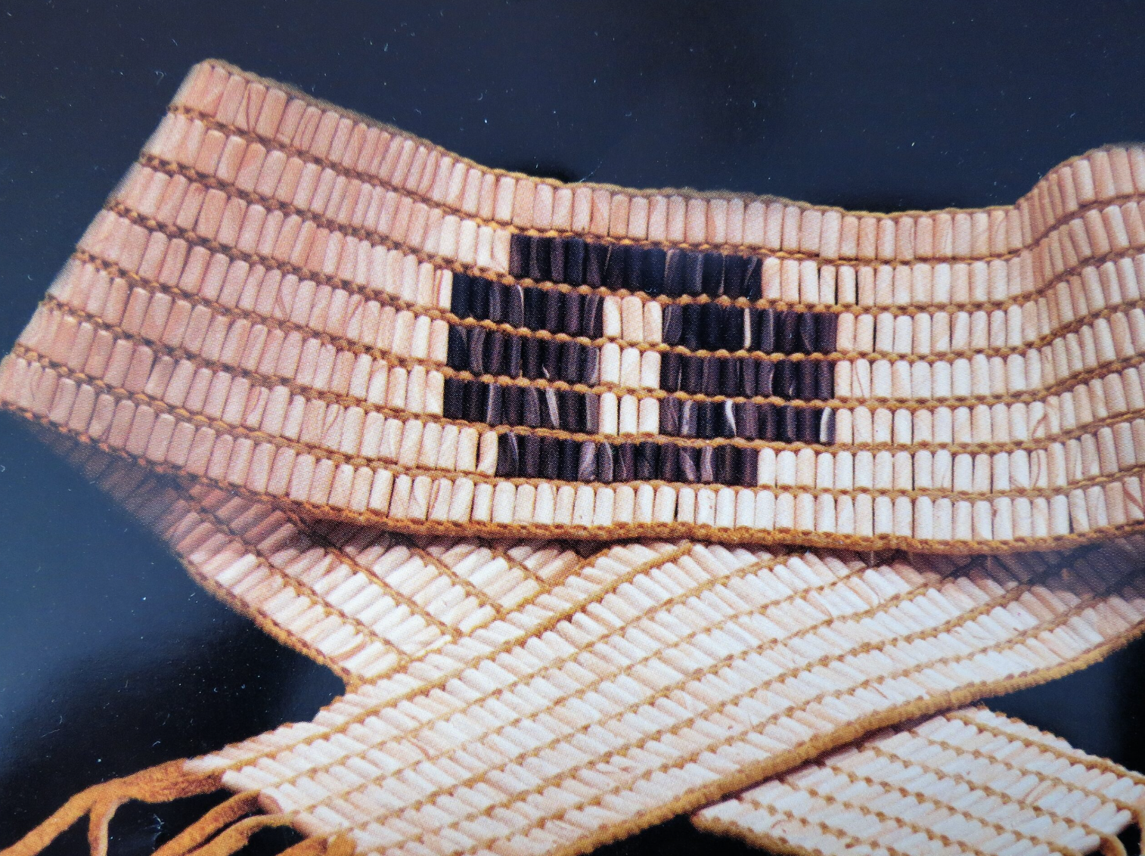
Land Acknowledgement
We recognise that we live, work and play on the traditional territory of many nations including the Mississaugas of the Credit, the Anishinaabeg, the Chippewa, the Haudenosaunee and the Wendat peoples, and is now home to many diverse First Nations, Inuit and Métis peoples. We acknowledge that Toronto is covered by Treaty 13 (The Toronto Purchase) which represents a sovereign relationship between the Mississaugas of the Credit and the Crown
Notes:
We recognise that we live, work and play on the traditional territory of many nations including the Mississaugas of the Credit, the Anishinaabeg, the Chippewa, the Haudenosaunee and the Wendat peoples, and is now home to many diverse First Nations, Inuit and Métis peoples. We acknowledge that Toronto is covered by Treaty 13 (The Toronto Purchase) which represents a sovereign relationship between the Mississaugas of the Credit and the Crown. Toronto is in the Dish With One Spoon Territory. The Dish With One Spoon is a treaty between the Anishinaabe, Mississauga and Haudenosaunee, that bound them to share the territory and protect the land. Subsequent Indigenous Nations and Peoples, Europeans and all newcomers have been invited into this treaty in the spirit of peace, friendship and respect. Under this covenant, we have to share the responsibility of ensuring the Dish is never empty, which includes taking care of the land and the creatures we share it with. We all eat out of the Dish with only one spoon, all of us that share this territory, We recognize the original caretakers of the land and the enduring presence of treaties that guide the relationships between nations and with the land for past, present and future. We are here to work together to build a healthy, caring and vibrant community, where all people can thrive in the present and for generations to come. We also recognize that a Land acknowledgment alone is not enough. It’s merely a starting point. In this spirit, we would like to share an Indigenous led resource called Native Land Digital (Native-Land.ca | Our home on native land). Their mission is to map Indigenous lands in a way that changes, challenges, and improves the way people see history and the present day, through mapping, education and community building. Image from https://education.afn.ca/afntoolkit/web-modules/plain-talk-4-treaties/1-treaties-and-why-they-are-important/

Slide 3
JRA Board of Directors:
Areas of Focus for 2024
Junction Residents Association
Annual General Meeting
November 2024

Slide 4
JRA Board Members (2022-2024 Term)
Mario Silva and Eleni (Helen) Vassilakos (Co-chairs)
Victoria Clare and Patricia Lai (Co-secretaries)
Katherine Morley (Treasurer)
Stephanie Claydon (Communications Coordinator)
Samantha Cooke (Membership Coordinator)
Sue Fleming and Mahima Madhava (Members-at-Large)

Slide 5
Fundraising
Membership Fees
Donations
More funding sources
Sponsorship
Function in the Junction Fundraiser
Notes:
In 2022, sources of funding for the JRA were primarily from Membership fees, donations from the community (including from the and some sponsorships.
The main focus of the board this year, was to secure other sources of funding, as we were not raising enough money to sustain our efforts.

Slide 6
Sponsorships
Notes:
To address this, we turned our attention to building on our successful relationships with current sponsors, such as Tuli Toronto Mortgage Expert, and securing more sponsorships. We were fortunate to recruit Sarah Lopes (an event planner whose specialty is corporate event planning). Sarah led the development of our Sponsorship strategy. With Sarah's guidance, we were able to significantly increase sponsorship funding and bring back the Function in the Junction as our annual fundraiser, taking place on Thursday, November 23.

Slide 7
Other Areas of Focus
Organizational Governance Model (Membership voted unanimously to approve the amendments for the new Board of Directors Model on September 11, 2024).
Elected Representatives
Collaboration with other Residents Associations (Federation of South Toronto Residents’ Associations: FOSTRA)
Notes:
Over the past year, the JRA Board has been reviewed the By-Laws to ensure the Board continuously improves how we operate and remain effective and efficient. As a result the Board of Directors proposed amendments to the By-laws to be considered by the Membership. These amendments were approved unanimously by the Members who voted on September 11, 2024.

Slide 8
Community Engagement and Events Steering Committee
Junction Residents Association
Annual General Meeting
November 2024

Slide 9
Community Engagement and Event Committee Members
Andrea Heywood
Helen Vassilakos
Laurence Dutil-Ricard
Mahima Madhava
Mario Silva
Patricia Lai
Samantha Cooke
Sarah Lopes
Stephanie Claydon
Sue Fleming
Tuli Parubets
Vicky Clare

Slide 10
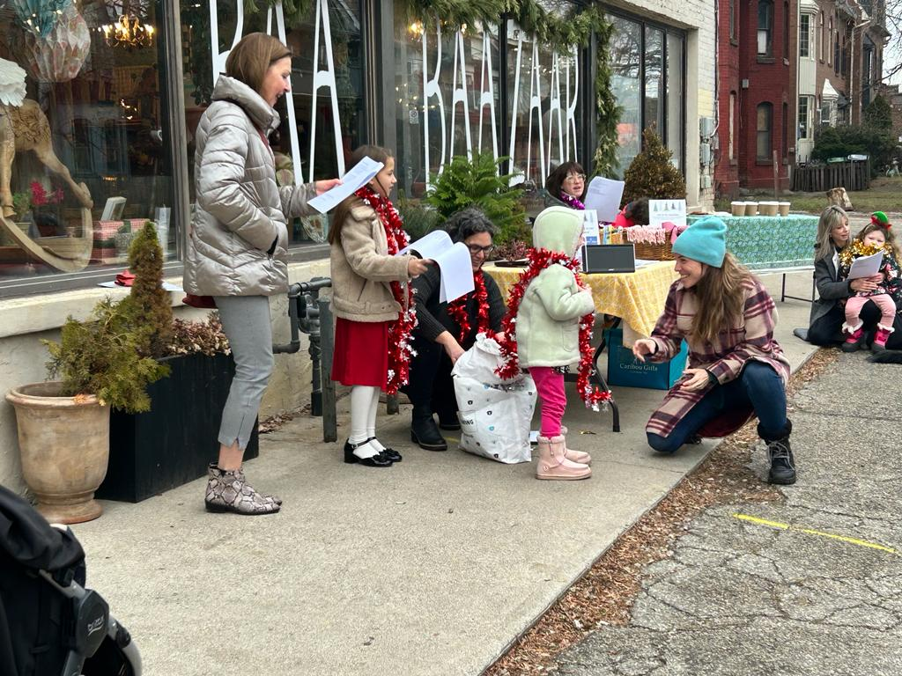
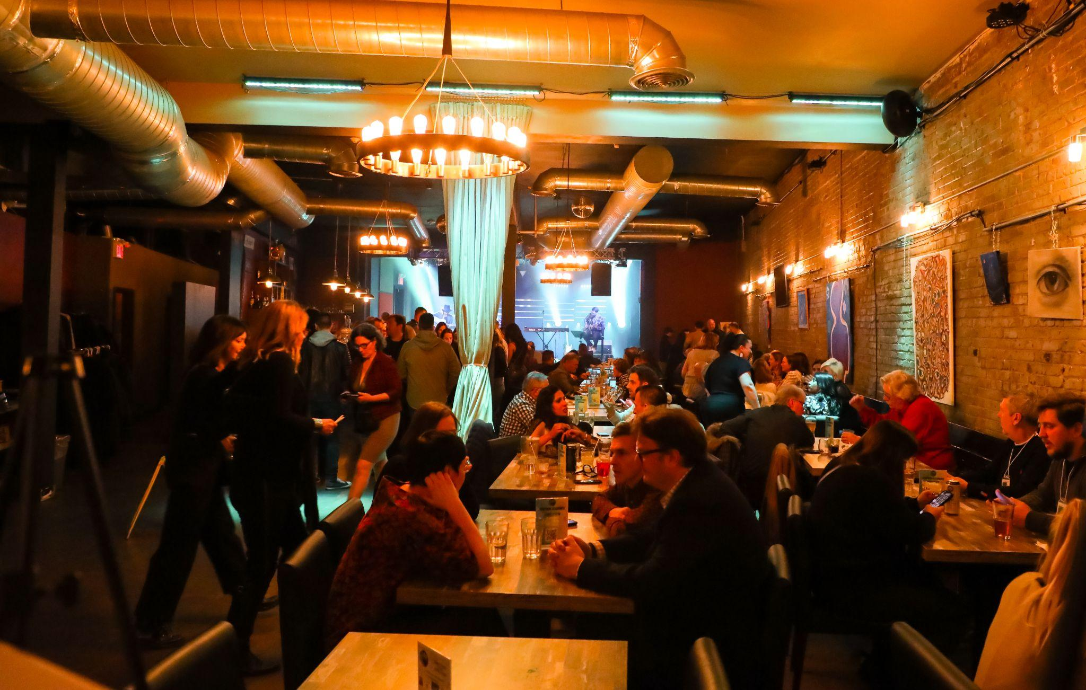
Winter 2023
Joy in the Junction - held on December 9th
The JRA hosted 2 sing-a-long sites at Baa Baazaar & the St. John’s Gazebo.
Donations were collected for a number of local charities through the JRA Charity Village account.
Gift cards collected were donated to:
The Sharing Place
Junction Place and
Four Villages Community Health Centre
Function in the Junction - held on November 23rd
The JRA hosted a new version of the Function in the Junction as our main fundraiser.
The event was a huge success, raising almost $9000 and with over 150 people in attendance.
Notes:
Carolers spent one night walking around the Junction, and at Community Sing-a-long sites, singing Christmas Carols and collecting gift card donations for us to distribute to organizations in The Junction. Approximately $1868 was donated during this event.
The JRA, on behalf of its members, also donated toys to the Caribou Gifts Toy Mountain Toy Drive. (cost was $196.11)
The JRA, on behalf of its members, also donated wool socks (along with a Tim Hortons gift card) to each resident of Junction Place. (cost of socks was $138.09)

Slide 11
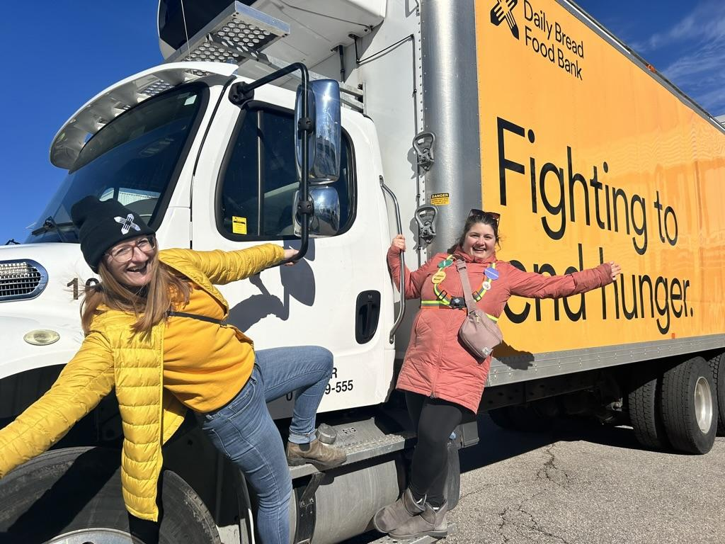
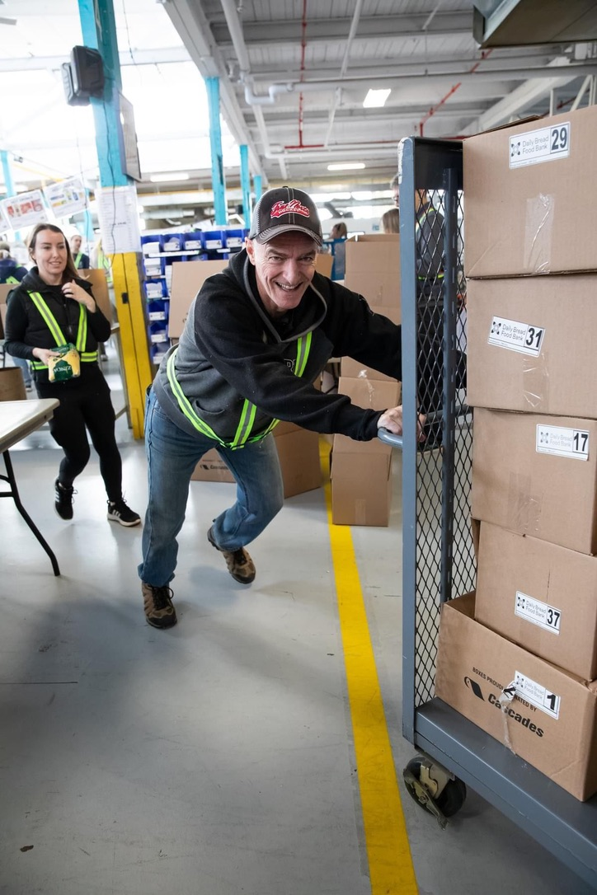
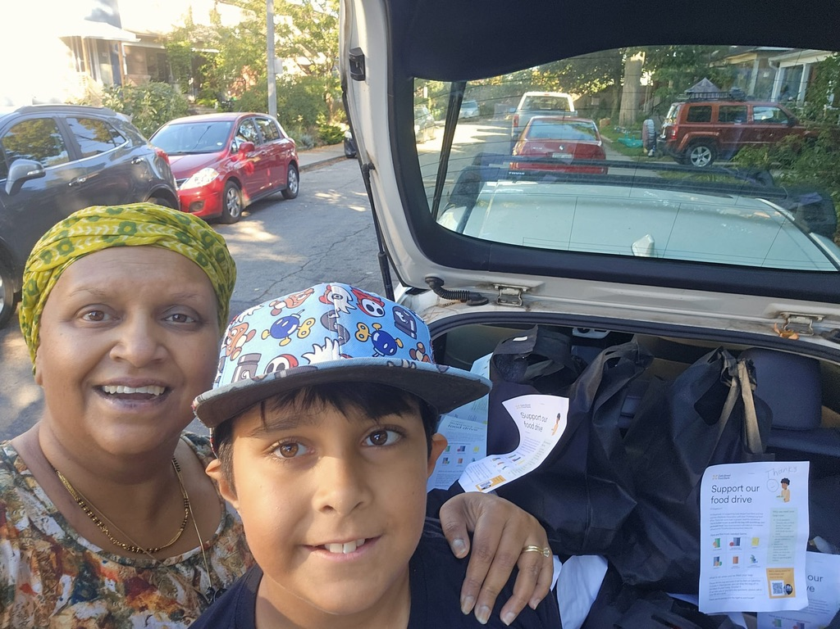
Spring 2024
Food Drives in Support of Daily Bread Food Bank We hosted two community food drives this year around Easter and Thanksgiving weekends. Both were a huge success. In April 2024 we collected over 13,000lbs of food and $1500 in cash donations In October 2024 we collected over 17,000lbs of food and $2000 in cash donations
This event is made possible by our many community champions and the dedicated volunteers on the Community Engagement Committee Through this initiative the JRA has the opportunity to take part in the DBFB community food sorts bi-annually
Notes:
On April 9, the JRA hosted our Spring Food Drive. With the support of the community we collected over 13 000 lbs of food and raised 1500
On October 5, the JRA hosting our Thanksgiving Food Drive
On May 6, the JRA hosted our first Janes Walk: Meet Me in the Junction. The event showcased our communities history, vibrancy, shops, cafes and live music venues.

Slide 12
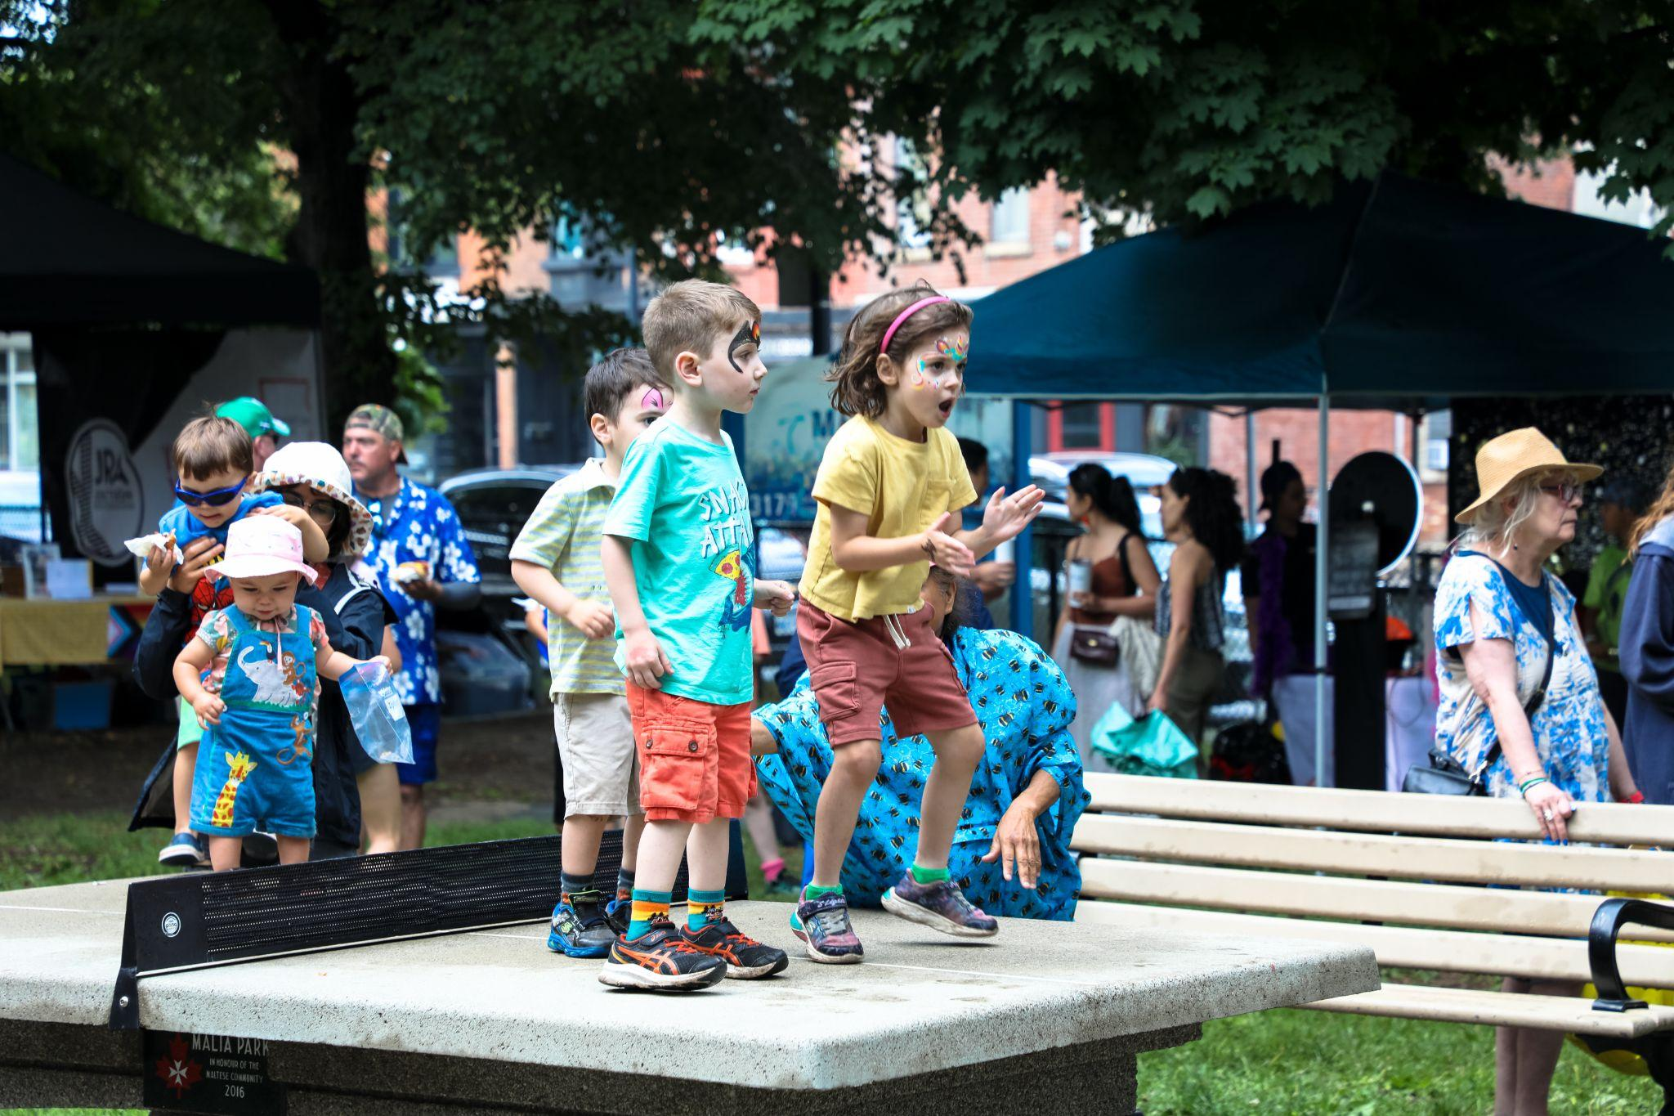
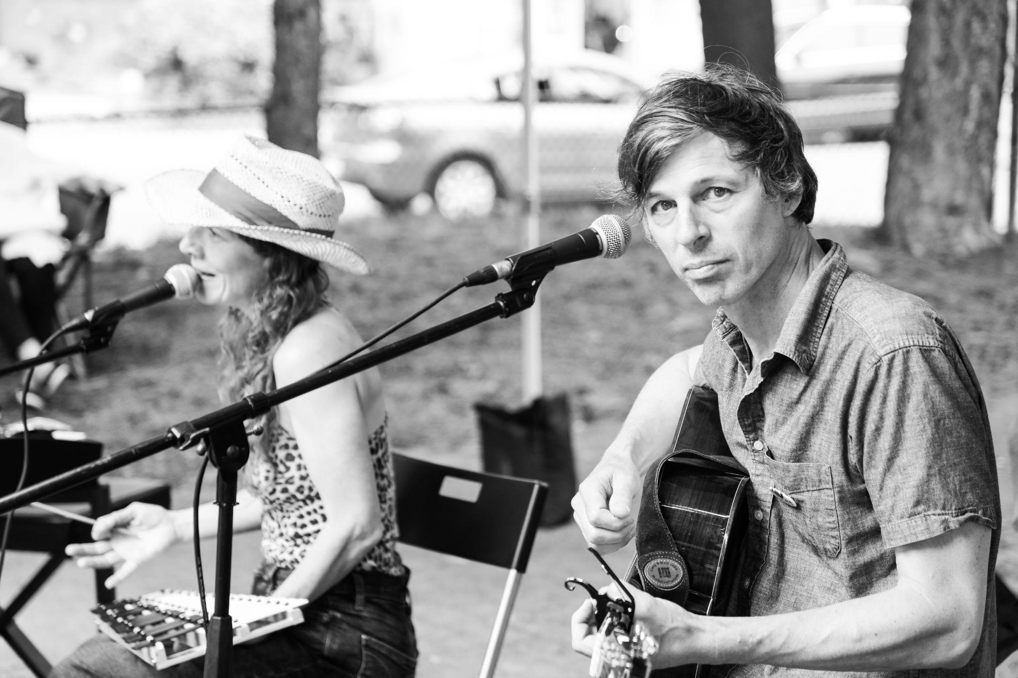
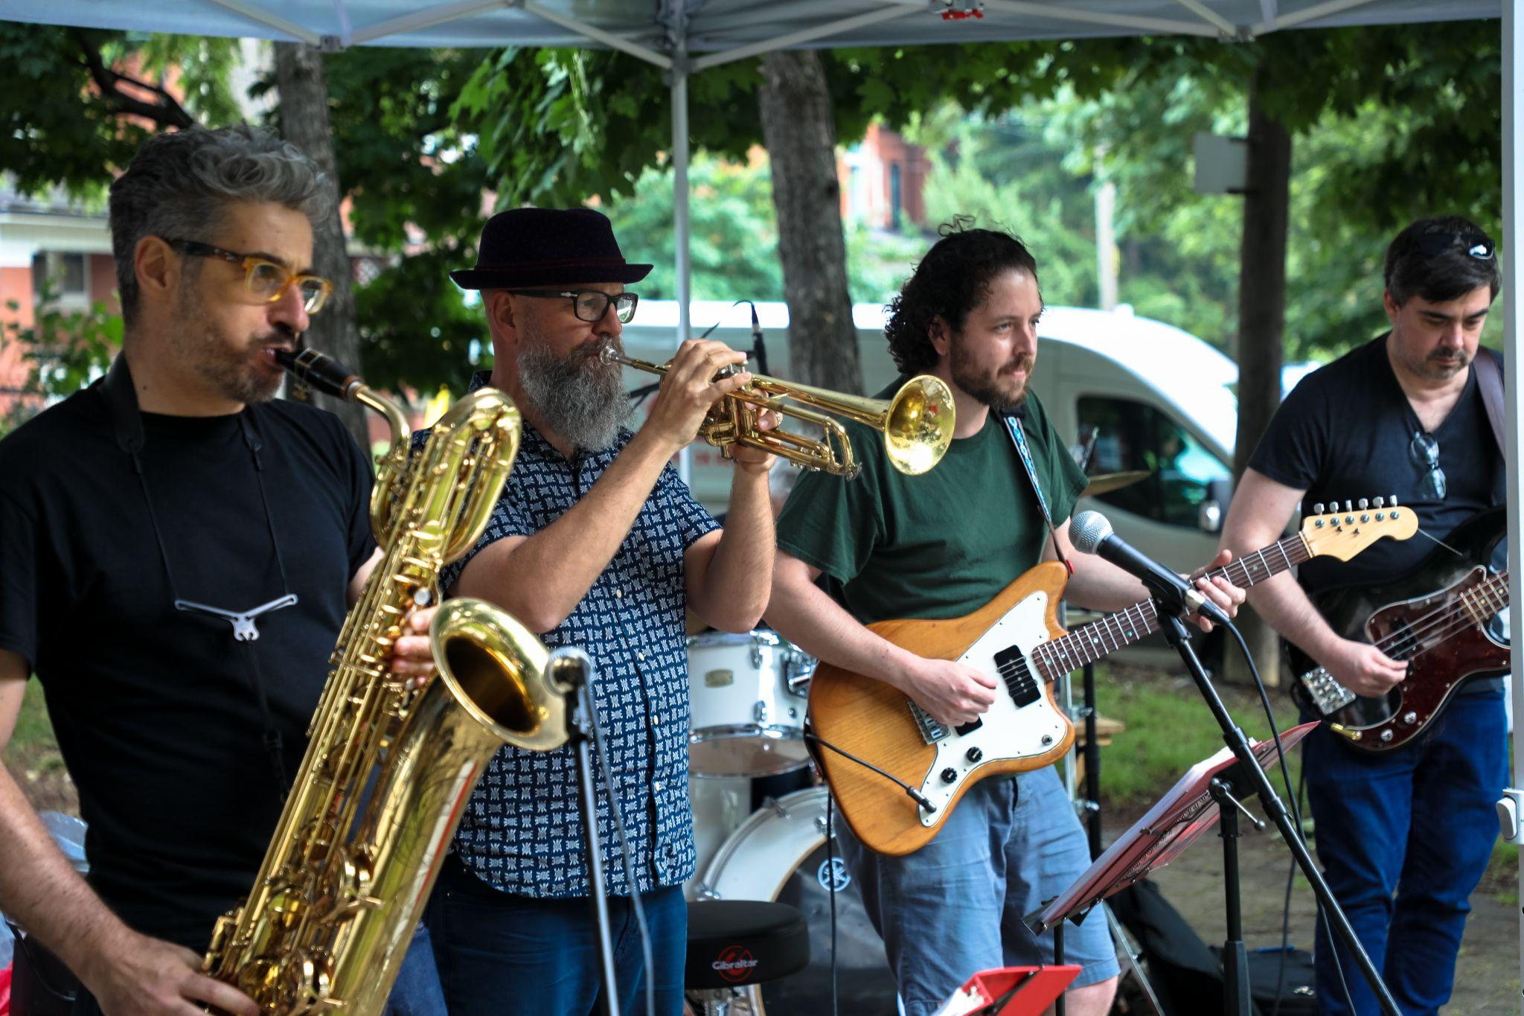
Summer 2024
3nd Annual JRA SummerFest (formerly Community Fun Day) on June 22nd.
Notes:
Building on the success of the 2021 Community Fun Day, the JRA kicked off the summer with our 2nd annual Community Fun Day on Sunday, June 25 at Malta Park. With the support of sponsors, this year’s event (including the food) was free to all attendees.

Slide 13
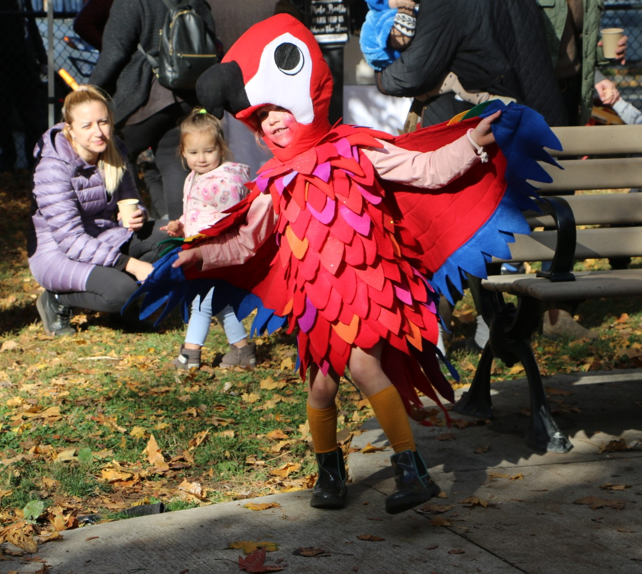
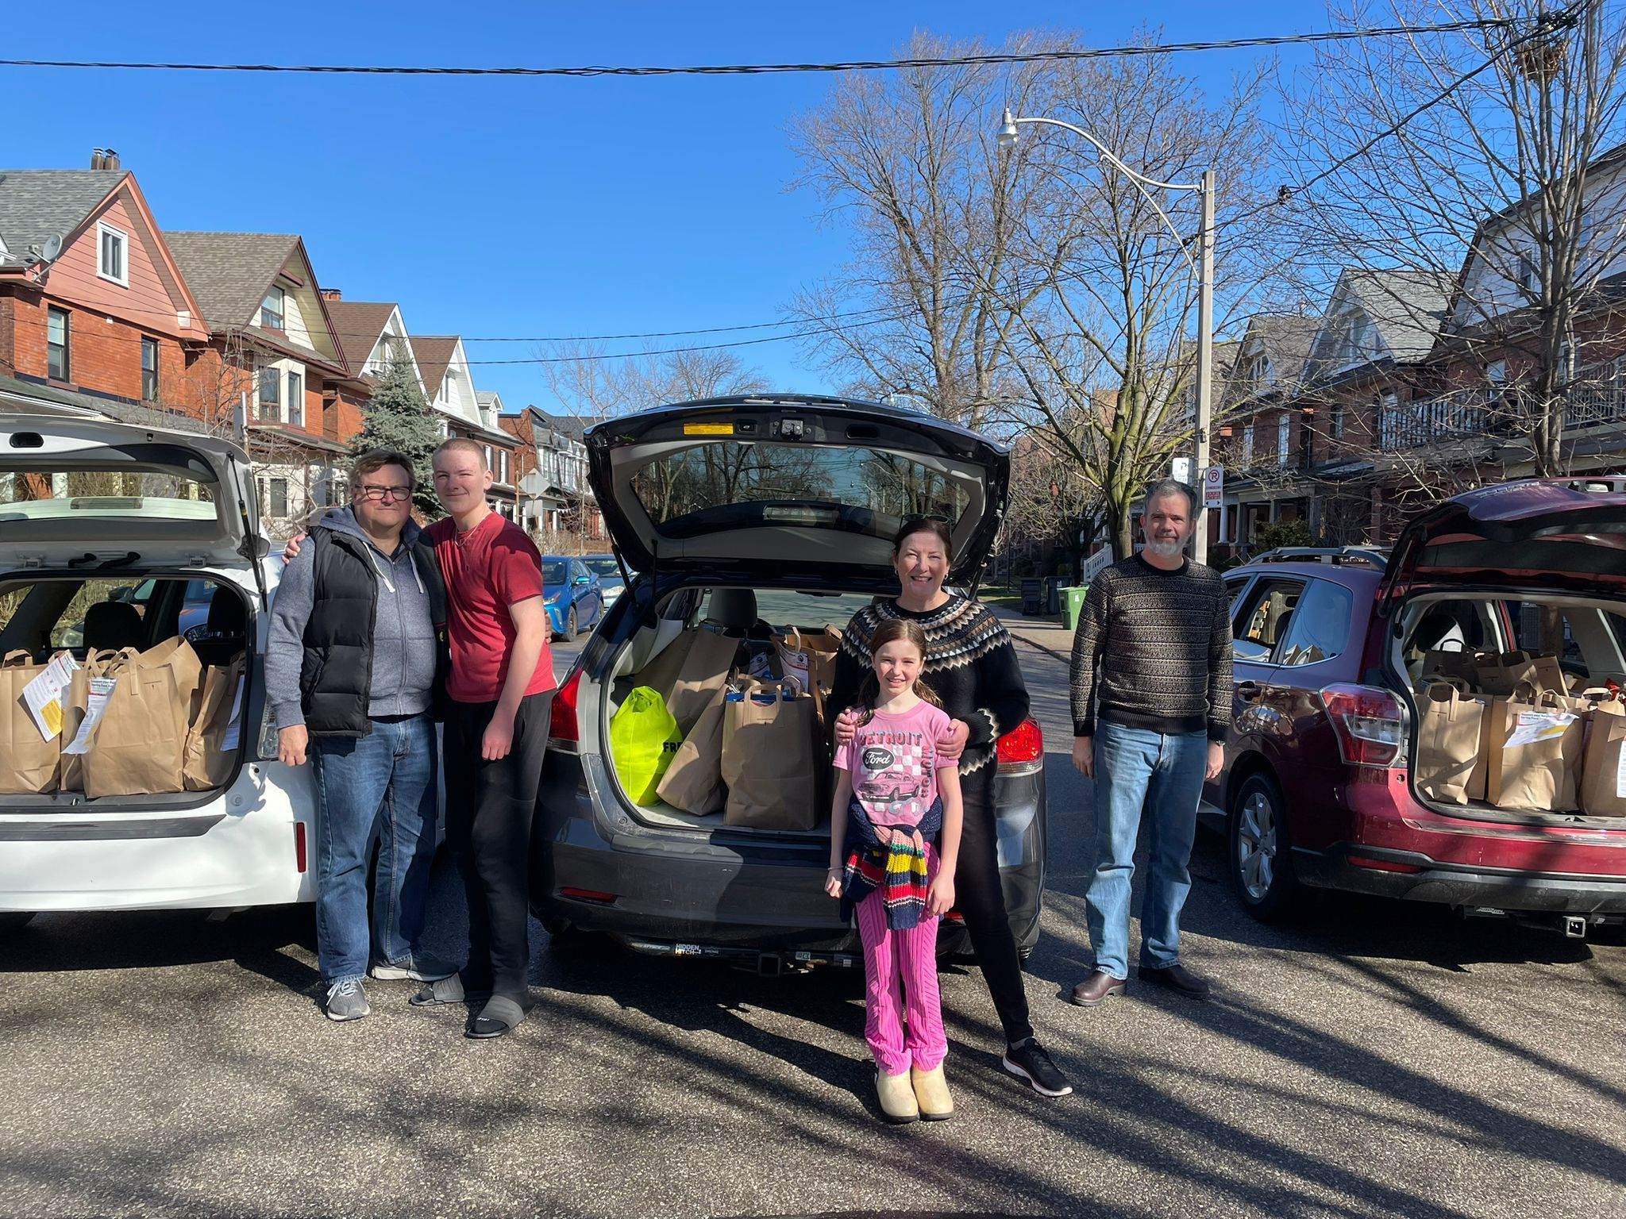
Fall 2024
JRA Halloween Howl
The JRA hosted its 3rd annual Halloween Howl on October 26th.
Notes:
On Saturday, September 23, the JRA hosted its first Movies By Moonlight at Malta Park. Our screening of The Princess Bride brought out over 50 community members to enjoy a magical evening under the stars.
On Saturday, September 30, the JRA hosted its Fall Food Drive. This fall, the JRA expanded its reach, and community members came through with a record breaking show of support. Over 20,000 lbs of food and $1600 in cash donations were raised.

Slide 14
Mark your Calendars - Upcoming events
(Winter 2024)
Nov 14 - Function In The Junction $95
Dec 14 - Joy In The Junction - volunteer to sing, or attend the sing-a-long at the St. John’s Gazebo between 1:30-3pm.
Notes:
The Function in the Junction Fundraiser is back. The event takes place on Thursday, November 23. Learn more or purchase tickets on our website at www.torontojra.com
Joy in the Junction takes place on Saturday, December 9th. This year there will be 2 locations for Sing A Longs - Baa Baazaar (406 Pacific Avenue -Pacific and Dundas w) and St. John’s Gazebo (at the corner of St. Johns Rd/Clendenan).

Slide 15
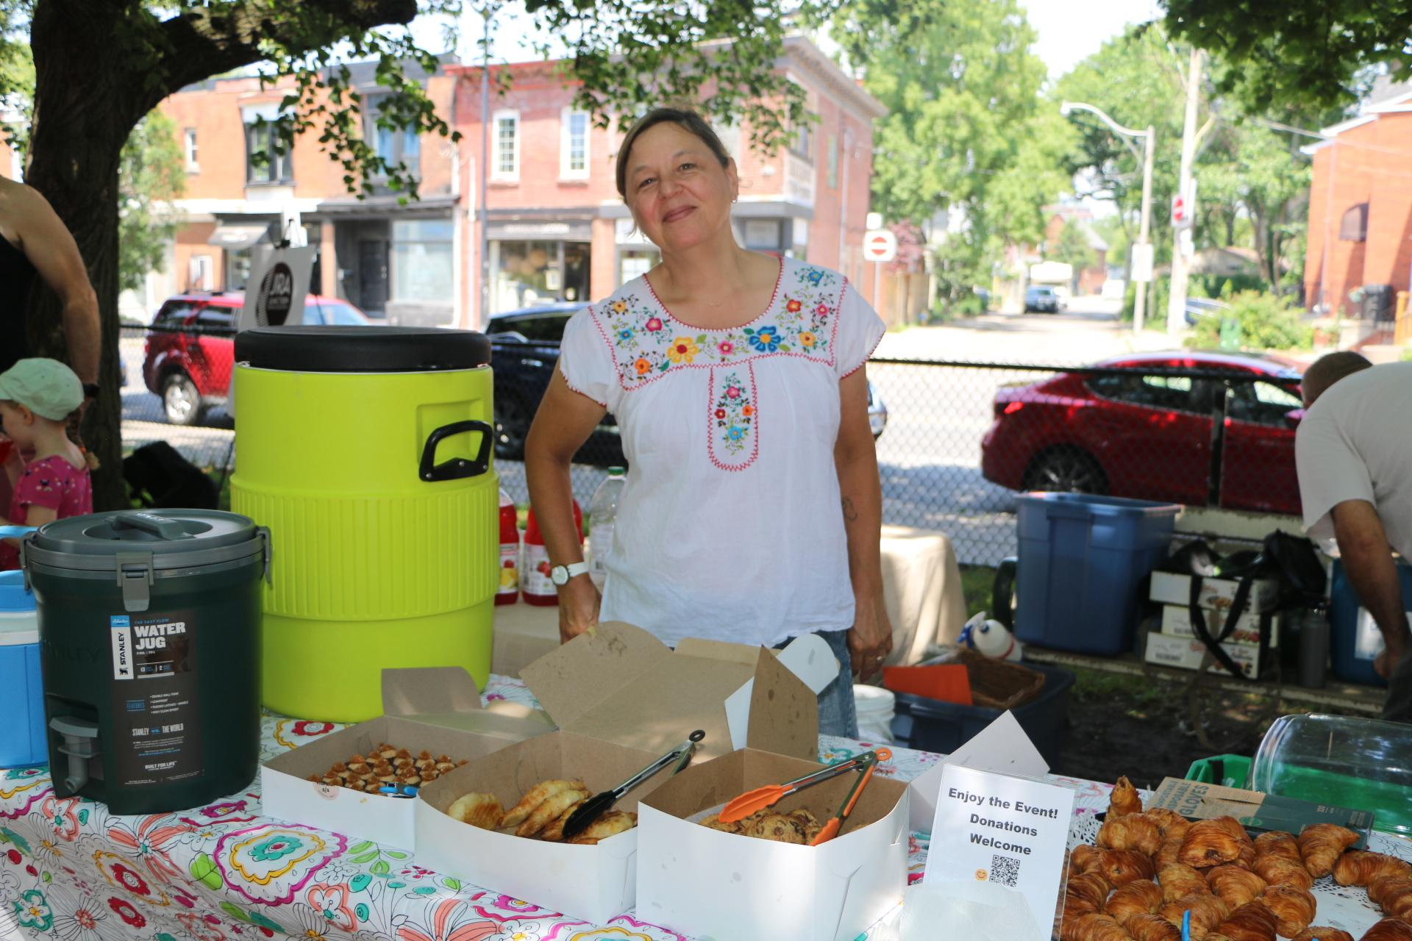
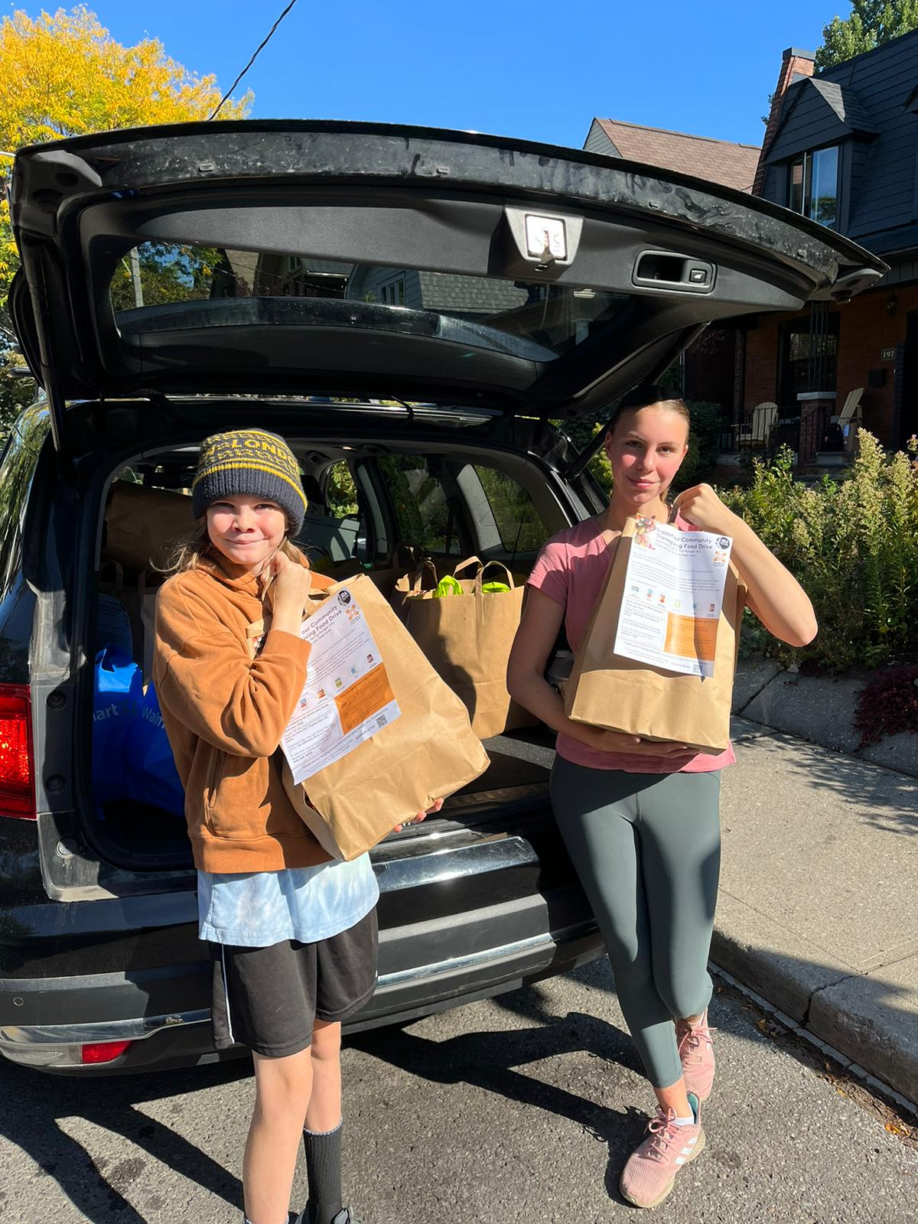
Volunteers making it happen
We are a volunteer led and run Association. We need YOU and have lots of fun ways to get involved:
Community Champions (for your street)
High School Volunteers
Event Volunteers
Register to become a JRA Volunteer TODAY!

Slide 16
Development and Community Spaces Steering Committee:
Design Your Main Street
Junction Residents Association
Annual General Meeting
November 2024

Slide 17
Development and Community Spaces Committee Members
Vicky Clare
Sue Fleming
Mario Silva
Helen Vassilakos

Slide 18
JRA’s ‘Development’ Committee
Purpose of the committee is to keep abreast of municipal land use policies or applications to the City for redevelopment. Where appropriate, possible and practical, engagement with proponents of change, residents and municipal officials is pursued to facilitate and support understanding and meaningful dialogue to resolving or mitigate impacts of ‘change’.
development applications on Dundas
Appeals to Ontario Lands Tribunal
EHON - Expanding Housing Options In Neighbourhoods
Junction Heritage Conservation District
FOSTRA (Fed of South Tor Residents Assoc)

Slide 19
‘Design Your Main Street’ initiative
The completion of the Design Your Main Street Survey provides a barometer of community sentiments to refer to and use in securing political support for whatever we see as opportunities for city undertakings.
IMPORTANT UPDATE:
THE INTENT OF THE DESIGN AND MAINSTREET DESIGN STUDY TO ADVOCATE FOR AN AVENUE STUDY ON DUNDAS HAS BEEN PREEMPTED BY THE CITY'S DECISION TO UNDERTAKE CITY WIDE STUDIES TO ENCOURAGE MAIN STREET INTENSIFICATION.
​

Slide 20
City-Wide Community Consultation: Resident Associations (Sept. 18, 2024)

Slide 21
Access to the September 18th Presentation can be found on the JRA website Design Your Main Street Junction Residents Association

Slide 22
Environmental Stewardship
Junction Residents Association
Annual General Meeting
November 2024

Slide 23
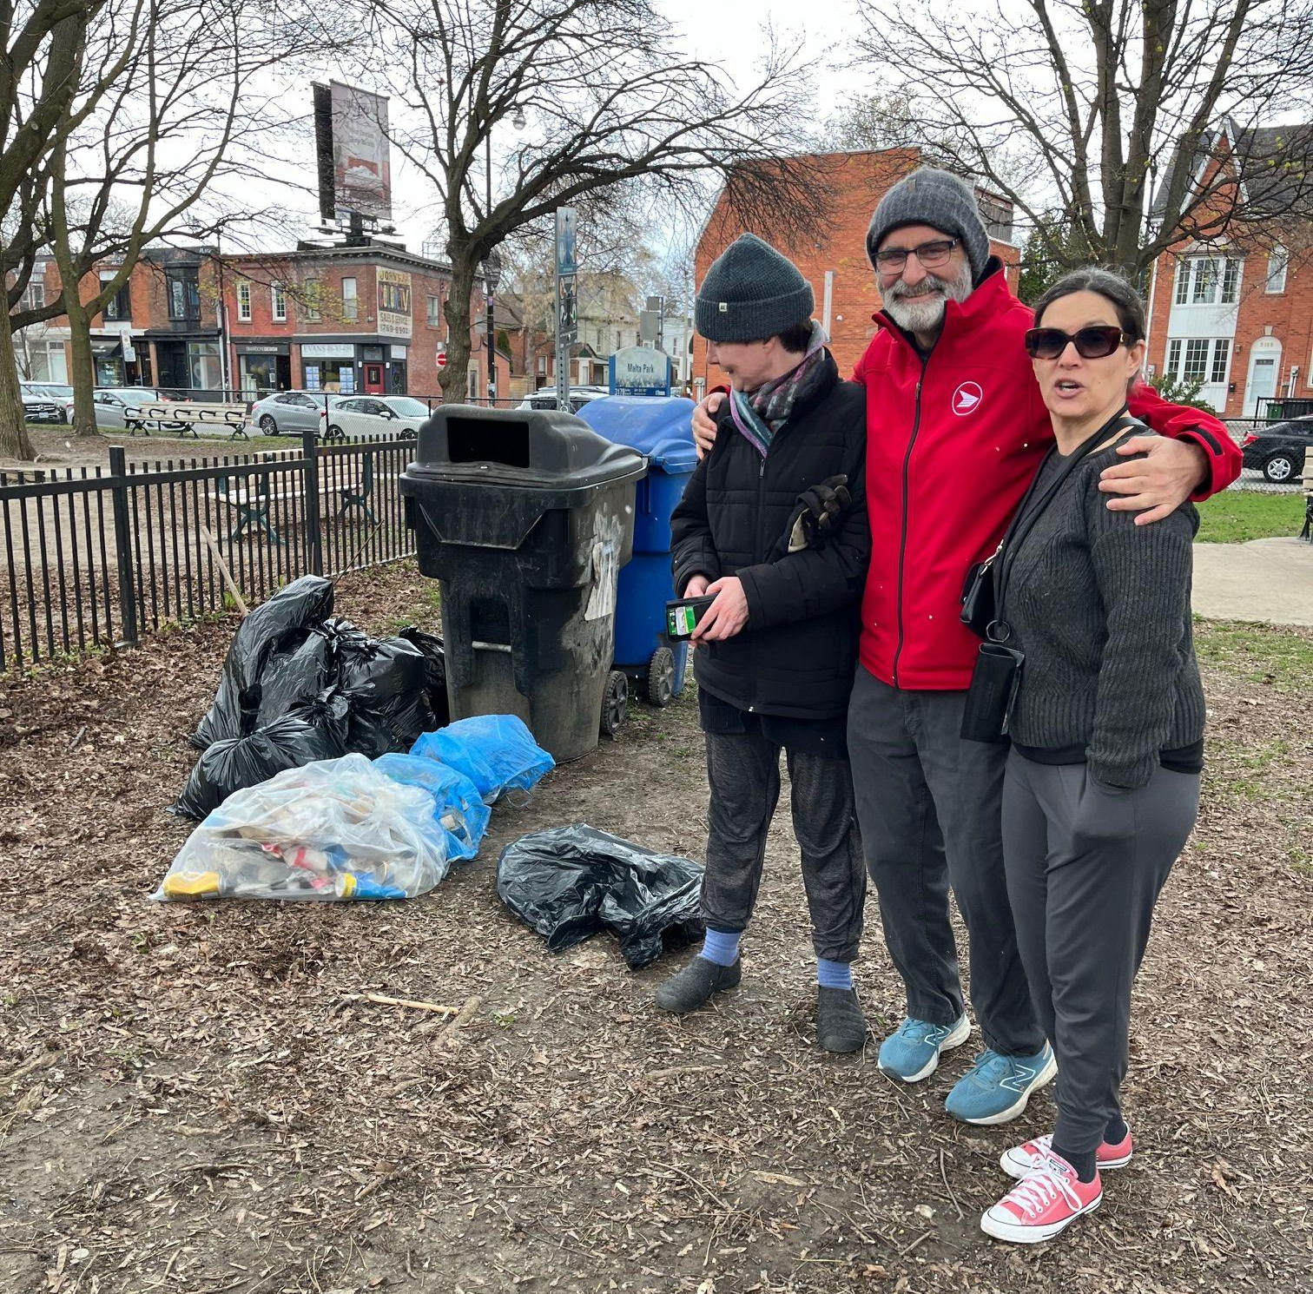
Clean Toronto Together 2024 in the Junction
Apr 2024
City of Toronto’s ‘Clean Toronto Together’ initiative - Saturday April 20
https://www.toronto.ca/expher/lore-enjoy/festivals-events/clean-toronto-toget
Participants allocated 30 minutes of their day to do a litter pick-up near their homes and brought their recycling and garbage bags to Malta Park for city collection.
Notes:
The JRA’s Environmental Stewardship committee coordinated our second annual neighbourhood litter pick-up on Saturday April 22 in support of the City of Toronto's Clean Toronto Together initiative. It was a foul weather day, but we that didn’t stop us.

Slide 24
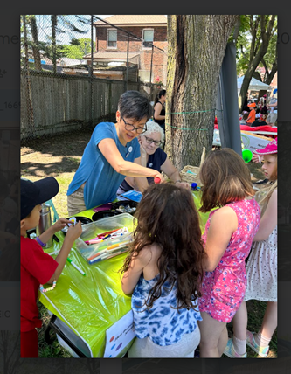
JAAST
Junction for Trees
In 2024, the JRA continued to share tree knowledge at community events and update resources on their website
In April, the JRA participated in a tree equity score survey, a collaborative project implemented by LEAF and the City of Toronto; the goal of the survey is to understand more about the needs and interests of community groups that are working on tree issues.

Slide 25
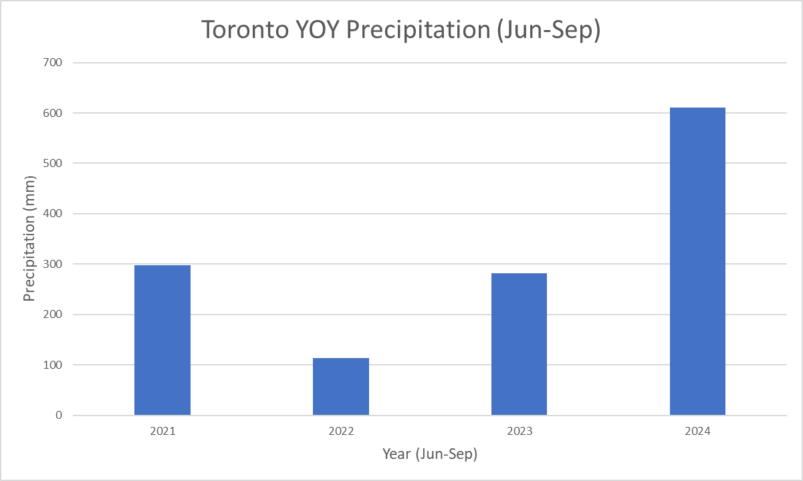
Watering street trees is essential (https://toronto.weatherstats.ca/)

Slide 26
Finances
Financial Statements
Projected Budget
Junction Residents Association
Annual General Meeting
November 2024

Slide 27
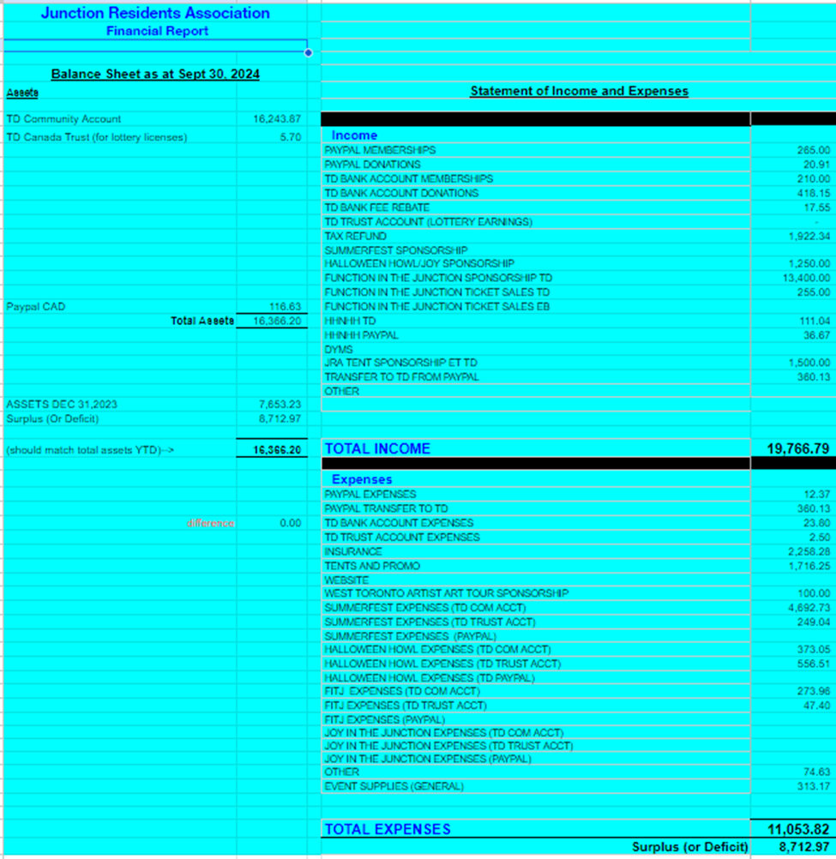

Slide 28
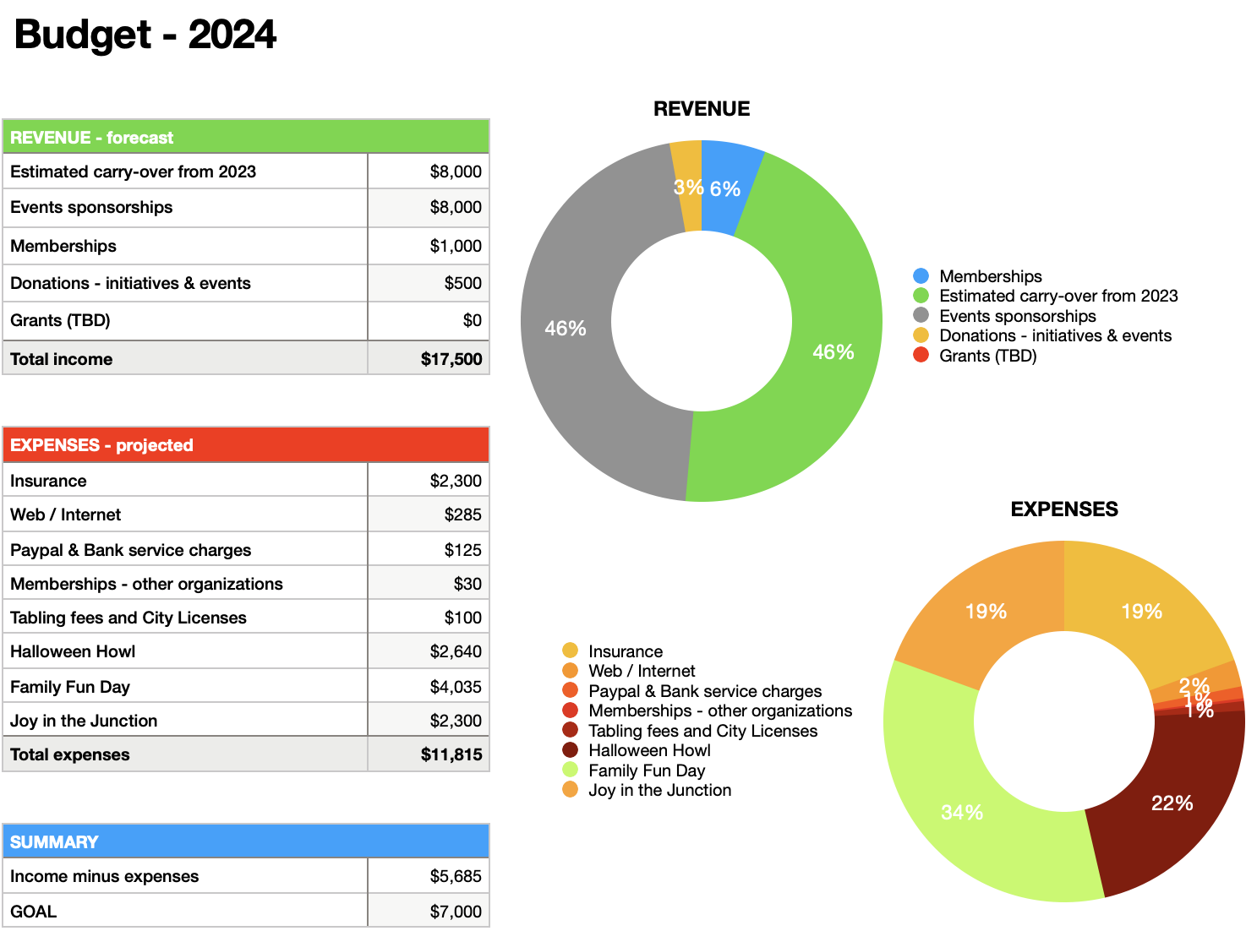

Slide 29
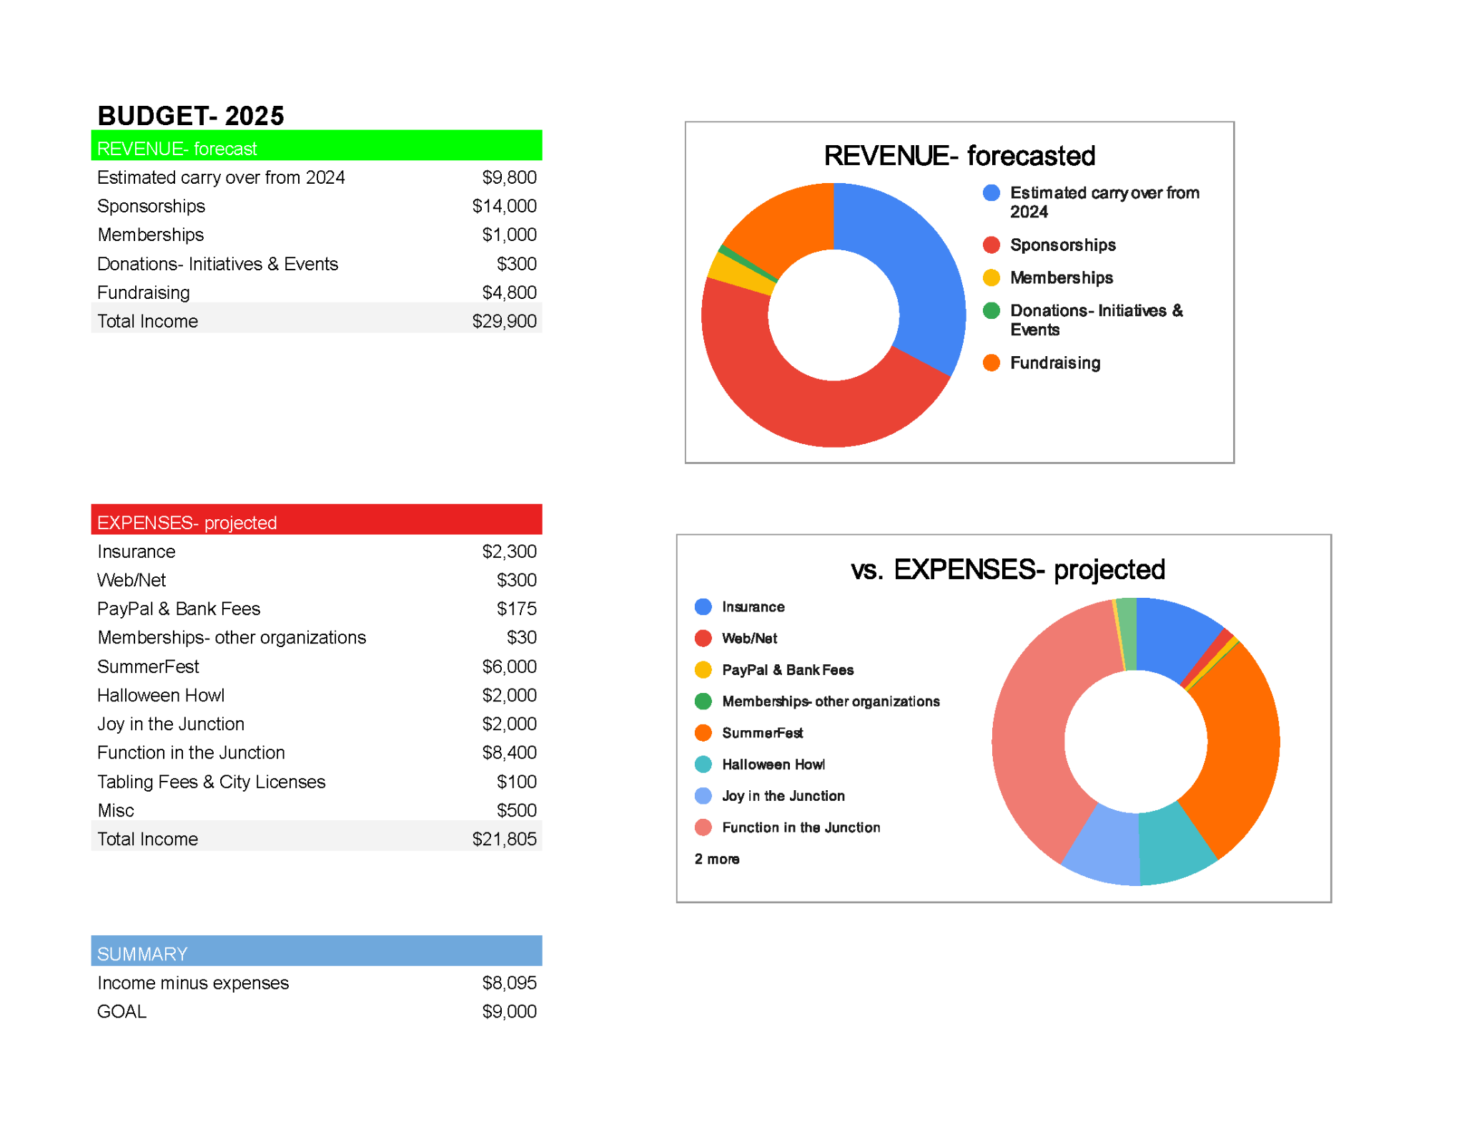

Slide 30
Q & A
Junction Residents Association
Annual General Meeting
November 2024

Slide 31
Voting
2025 Budget
Board of Directors
Junction Residents Association
Annual General Meeting
November 2024

Slide 32
Voting Process
Projected Budget
The Projected Budget for 2025 will be voted on. Approval will be based on the majority of the Members present or vote by proxy.
Board of Directors
Each position will be voted on individually.
Members will have an opportunity to nominate other members for a specific position at the AGM. The nomination will need to be seconded by another member.
This process will continue until all nominees are identified for the position.
There will either be a vote, or candidates will be acclaimed by being declared elected, based on how many nominees are identified for each position.
Each candidate or nominee will have a minute or so to address the members before the vote takes place.
We will then take a vote by show of hands. Board Members will be selected based on majority.

Slide 33
Open Discussion
Junction Residents Association
Annual General Meeting
November 2024

Slide 34
Thank you!

